Slide 1
Standards
5GPPP –assumed technical requirements
Data rate – most extreme example - Media and Entertainment Industry with maximum values in the order of Gb/s
Mobility - most extreme example - 500 km/h requirement for the transport sector
End to end latency –most extreme example - factories of the future with minimum values of 100 microseconds to 10 milliseconds
Density – factories again - maximum requirement of 100 devices per square meter
Reliability - maximum requirement of 99.99999% for eHealth
Position accuracy - most demanding vertical use case - automotive industry with minimum values of 0.3 meters

Slide 2
IMT 2020
IMT 2000(3G) IMT2000 Advanced (4G)
Requirements for a 5G network described in the IMT2020 Vision September 2015 and include a peak data rate of 20 Gbit/s, a latency of 1 millisecond, improved energy and spectrum efficiency and the ability to support increased network density.
Higher data rates and improved spectrum efficiency are needed to increase network value and improve network delivery economics, better energy efficiency and coverage are needed for IOT service, lower latency is needed for gaming and telemedicine and lower latency and low packet loss are needed for safety critical machine type communication (MTC) including Intelligent Transport Systems (ITS).
Enhanced coverage highlighted as a requirement for automotive and PPDR (Public Protection and Disaster Relief) applications.
http://www.itu.int/en/ITU-R/study-groups/rsg5/rwp5d/imt-2020/Pages/default.aspx

Slide 3
IMT 2020 Standards and spectrum
Rel 8 dual carrier HSPA Rel 9 dual band dual carrier HSPA
Rel 10 four carrier HSPA
Rel 11 eight carrier HSPA
Rel 12 Freeze date September 2014
Rel 14 and 15 coinciding with WRC 2015
Included L band 1437 to 1525 MHz and 3.4 to 3.6 GHZ and 3.8 - 4.2 GHZ
Present discussions include debate about stand alone or non stand alone (use of LTE control plane)

Slide 4
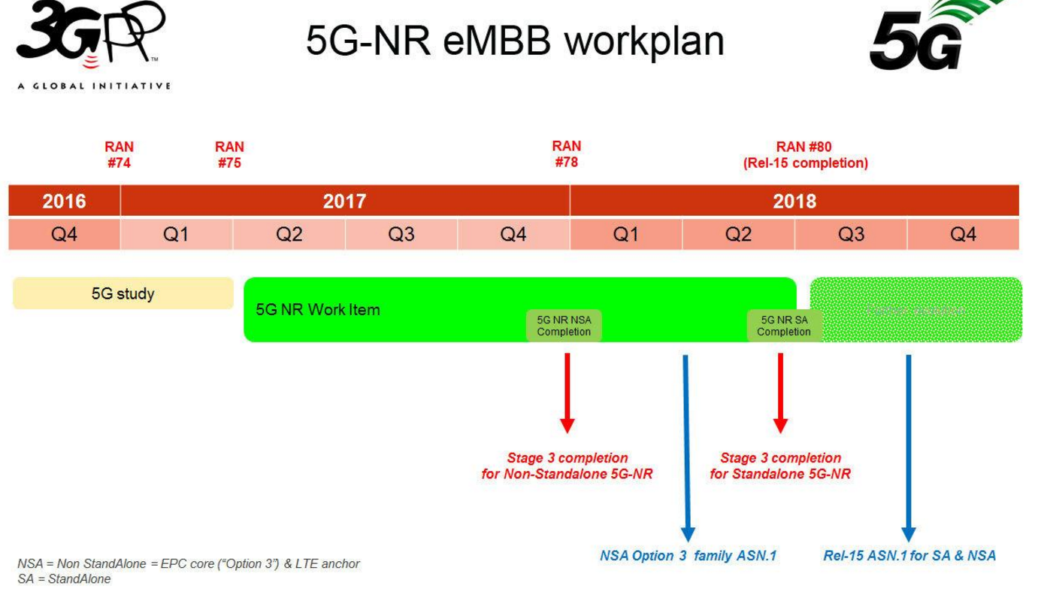
IMT 2020 Standards and spectrum

Slide 5
IMT 2020 Standards and spectrum
Rel 9 introduced Bands 18 and 19 LTE 800 for Japan, Band 20 and 21, LTE 1500 for Japan and MBSFN
Rel 10 LTE Advanced – Carrier aggregation
R11 new frequency bands including downlink only 717 to 728 MHz (US Channel 55 Media FLO) for CA with Bands 2 and 4
R12 completion 2014 - includes 461 to 468 and 451 to 458 MHz for Brazil (Band 31), 1670 to 1675 and 1646 to 1651 MHz for the US, 2350 to 2360 and 2305 to 2315 MHz WCS band for the US (Band 70)
R12 study item to repurpose 30 MHz satellite spectrum adjacent to Band 1
Band 71 (US 600 MHz)
Wi-Fi/LTE (inter RAT) carrier aggregation

Slide 6
IMT 2020 Time and frequency domain
LTE Advanced Pro specified in Release 13 – increases five component carriers (5X 20 MHz=100 MHz) to potentially 32
Problems of cross isolation between bands (inter band CA)
High peak to average ratio for intra band and requirement to support 26 dBm (400 milliwatts)
Envelope tracking is band width limited to 20 or 40 MHz and projects noise into the receive path
Phase 1 5G Release 15 due in late 2018 concentrates on sub 6 GHz (including 3.8-4.99 GHz)
256 QAM and 4x4 MIMO
Release 16 (Phase 2) includes 28 and 38 GHz based beam forming
Release 15 by June 2018
Release 16 by December 2019
0.1 millisecond sub frames
15, 30, 60, 120, 240, 480 KHz sub carriers

Slide 7
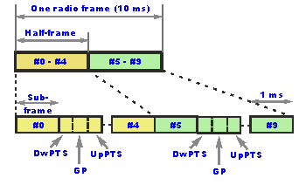
IMT 2020
2G GSM 20 millisecond frame rate (voice syllabic rate) 13 kilobit voice codec with 3k/bits of coding=16 kbps= 144 kbps ISDN
3G ATM 10 millisecond
4G 10 milliseconds but with sub frames –two half frames- each half frame split into 5 one millisecond frames
5G 0.1 millisecond – theoretical benefit is layer 1 latency, multiplexing efficiency and power efficiency gain (sub frames, slots and mini slots)
Principle of lean transmission (improve throughput to overhead ratio also known as ‘good put’)
Coexistence of LTE and 5G ‘New Radio’ coexistence in the same spectrum
Access/backhaul integration (study item for 2017)
Need to minimize signalling overhead due to stringent time synchronization required to maintain orthogonality between different UEs

Slide 8
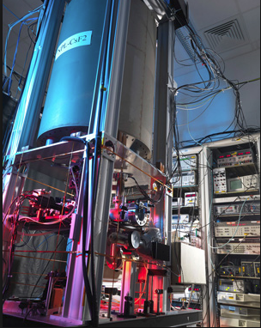
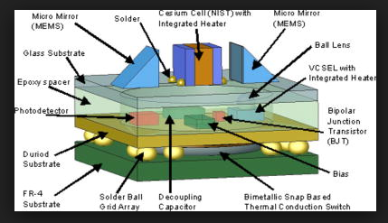
5G Timing
The time and phase reference in LTE TDD and LTE Advanced has to be traceable back to Coordinated Universal Time and requires a phase accuracy of +- 1.5 microseconds for cell radii of up to 3 kilometres and +- 5 microseconds for cell radii over 3 kilometres.
This is defined by the ITU standard ITU-T G.8272 and needs to compensate for variable delay introduced by router hardware and routing flexibility.
The base unit of Coordinated Universal Time is the SI (International System of Units) second. The Si second is defined by a caesium fountain atomic clock.
Chip Scale Atomic Clock Programme financed by DARPA with the mission to produce a miniature atomic clock https://www.microsemi.com/products/timing-synchronization-systems/quantum-chip-scale-atomic-clock-intro

Slide 9
5G Sub Carrier spacing

Slide 10
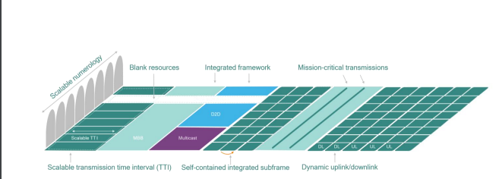
5G Sub Frames

Slide 11
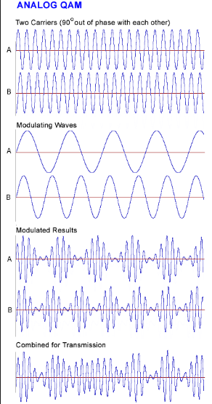
Higher order modulation and coding

Slide 12
The terrestrial 4G and 5G standards process
http://www.ericsson.com/research-blog/lte/release-14-the-start-of-5g-standardization/
The ratification of 5G standards is scheduled as a series of work items from Release 14 and aligned with the WRC process
Phase A | Phase B | Phase C
2012 | 2013 | 2016
Release 10 and 11 | Release 12 and 13 | Release 14, 15 and 16
WRC-12 | WRC 15 | WRC 19

Slide 13
The terrestrial 4G and 5G standards process
5G ‘NR’ 3GPP ‘new radio’ study item
OFDM based new radio layer
Evolves from Release 14 Enhanced Licensed Assisted Access, NB-IOT and LTE V2X
Includes Pro Se – device to device pairing and co existence with 802.11p

Slide 14
IMT 2020
ITU Draft Dc 5/40E/Feb/17
E MBB Enhanced mobile broadband
LMLC Low mobility large cell
mMTC Massive machine type communications
URLLC Ultra-reliable and low-latency communications

Slide 15
IMT 2020 EmBB Peak data rate
The maximum achievable data rate under ideal conditions (in bit/s)= received data bits assuming error-free conditions assignable to a single mobile station, when all assignable radio resources for the corresponding link direction are utilized (excluding radio resources that are used for physical layer synchronization, reference signals or pilots, guard bands and guard times).
The minimum requirements for eMBB peak data rate downlink peak data rate is 20 Gbit/s. – Uplink peak data rate is 10 Gbit/s.

Slide 16
IMT 2020 Definitions Peak data rate
This requirement is defined for the purpose of evaluation in the eMBB usage scenario.
Minimum requirements for peak data rate
Downlink peak data rate 20 Gbit/s
Uplink peak data rate 10 Gbit/s.

Slide 17
IMT 2020 EmBB Spectral efficiency
Peak spectral efficiency is the maximum data rate under ideal conditions normalised by channel bandwidth (in bit/s/Hz), where the maximum data rate is the received data bits assuming error-free conditions assignable to a single mobile station, when all assignable radio resources for the corresponding link direction are utilized (excluding radio resources that are used for physical layer synchronization, reference signals or pilots, guard bands and guard times).
Minimum requirements
Downlink peak spectral efficiency 30 bit/s/Hz
Uplink peak spectral efficiency 15 bit/s/Hz.
These values are defined assuming an antenna configuration to enable 8 spatial layers (streams) in the downlink and 4 spatial layers (streams) in the uplink.

Slide 18
IMT 2020 User experienced data rate
User throughput (during active time) is defined as the number of correctly received bits, i.e. the number of bits contained in the service data units (SDUs) delivered to Layer 3, over a certain period of time.
In case bandwidth is aggregated across multiple bands (one or more TRxP layers), the user experienced data rate will be summed over the bands.
The target values for the user experienced data rate Dense Urban – eMBB
Downlink 100 Mbit/s.
Uplink 50 Mbit/s.

Slide 19
IMT 2020 Spectral Efficiency
A percentile (or a centile) is a measure used in statistics indicating the value below which a given percentage of observations in a group of observations fall. For example, the 5th percentile is the value (or score) below which 5% of the observations may be found.

Slide 20
IMT 2020 User Plane Latency
User plane latency is the contribution of the radio network to the time from when the source sends a packet to when the destination receives it (in ms).
It is defined as the one-way time it takes to successfully deliver an application layer packet/message from the radio protocol layer 2/3 SDU ingress point to the radio protocol layer 2/3 SDU egress point of the radio interface in either uplink or downlink in the network for a given service in unloaded conditions, assuming the mobile station is in the active state.
This requirement is defined for the purpose of evaluation in the eMBB and URLLC usage scenarios.
The minimum requirements for user plane latency are
4 millisecond for eMBB
1 millisecond for URLLC assuming unloaded conditions (i.e., a single user) for small IP packets (e.g., 0 byte payload + IP header), for both downlink and uplink.

Slide 21
IMT 2020 Control Plane Latency
Control plane latency Control plane latency refers to the transition time from a most “battery efficient” state (e.g. Idle state) to the start of continuous data transfer (e.g. Active state).
This requirement is defined for the purpose of evaluation in the eMBB and URLLC usage scenarios.
The minimum requirement for control plane latency is 20 milliseconds.
Proponents are encouraged to consider lower control plane latency, for example10 milliseconds.

Slide 22
IMT 2020 Connection Density
Connection density is the total number of devices fulfilling a specific quality of service (QoS) per unit area (per km2).
This requirement is defined for the purpose of evaluation in the mMTC usage scenario.
The minimum requirement for connection density is 1million devices per km2 .

Slide 23
IMT 2020 Reliability
Reliability relates to the capability of transmitting a given amount of traffic within a predetermined time duration with high success probability.
Reliability is the success probability of transmitting a layer 2/3 packet within a required maximum time, which is the time it takes to deliver a small data packet from the radio protocol layer 2/3 SDU ingress point to the radio protocol layer 2/3 SDU egress point of the radio interface at a certain channel quality.
This requirement is defined for the purpose of evaluation in the URLLC usage scenario.
The minimum requirement for the reliability is 1 in10-5 success probability of transmitting a layer 2 PDU (protocol data unit) of 32 bytes within 1 millisecond at coverage edge for the Urban Macro-URLLC test environment, assuming small application data (e.g. 20 bytes application data + protocol overhead).
Proponents are encouraged to consider larger packet sizes, for example layer 2 PDU size of up to 100 bytes.

Slide 24
IMT 2020 Energy Efficiency
Network energy efficiency - the radio access network energy consumption in relation to the traffic capacity provided.
Device energy efficiency - the power consumed by the device modem in relation to the traffic characteristics.
Network energy efficiency when loaded and no loaded (no data)
Energy consumption when there is no data can be estimated by the sleep ratio, the ratio of the fraction of unoccupied time resources (for the network) or sleeping time (for the device) in a period of time corresponding to the cycle of the control signalling (for the network) or the cycle of discontinuous reception (for the device) when no user data transfer takes place.
In 3GPP Release 12, LTE 2 Cat 0 IOT devices are allowed to decide how often they need to be active in order to transmit and receive data.
In the lowest power saving mode, the device does not look for paging or any other network signalling, the network is not allowed to page the device and is required to hold any data that arrives until a designated wake up moment.
The time between wake up moments can be up to 12.1 days though something closer to two minutes is more common. The standard discontinuous receive cycle is 2.56 seconds.

Slide 25
IMT 2020 Energy Efficiency

Slide 26
IMT 2020 Mobility
Mobility is the maximum mobile station speed at which a defined QoS can be achieved (in km/h).
The following classes of mobility are defined:
Stationary: 0 km/h
Pedestrian: 0 km/h to 10 km/h
Vehicular: 10 km/h to 120 km/h
High speed vehicular: 120 km/h to 500 km/h

Slide 27
Signalling and energy efficiency
Power control and handover complexity in mobile broadband
Cell to cell, channel to channel, band to band, inter and intra system handovers
Hard to manage using CQI
Use of other prediction algorithms?
Google and Facebook?

Slide 28
5G Definitions
A European METIS definition of 5G Mobile and wireless communications Enablers for the Twenty-twenty Information Society | A vendor definition of 5G (Ericsson) | A 5G PPP definition of 5G
Ten to one hundred times higher typical user data rate in a dense urban environment with a typical user data rate ranging from one to ten Gbps | 10X -100X increase in peak data rate
One thousand times more mobile data per area (per user) with a volume per area (per user) of 100 Gbps/km2 based on a typical individual usage per month of 500 Gbytes. | 1000 X increase in mobile data volume | 1000 times increase in the number of connected devices reaching a density of >- 1m terminals/km2
Ten to one hundred times more connected devices | 10 to 100 X increase in connected devices
Ten times longer battery life for low-power massive machine communications where machines such as sensors or pagers will have a battery life of a decade | 10X battery life extension for low power devices | 1/10x decrease in energy consumption compared to 2010
Support of ultra-fast application response times for example for the tactile internet where the end-to-end latency will be less than 5 milliseconds with high reliability | 5X lower latency | 1/5 X decrease in end to end latency reaching 5 milliseconds for tactile internet and radio link latency reaching a target of <- one millisecond for Vehicle to Vehicle Communications (V2V)
A similar cost and energy dissipation per area as today’s cellular systems.
 |  | 99.999% aggregate service reliability for safety critical services Mobility support at speed >-500 km/h for ground transportation
 |  | Accuracy of outdoor location of <- 1 metre
 |  | Support for shared infrastructure, multi-tenancy and multi radio access technologies with seamless handover

Slide 29
IOT and MTC
Assumption that IOT will save the day but problem of multiple standards
 | NB-CIoT | NB-LTE | NB-IoT (Rel-13 Work Item)
 |  |  | Single Tone | Multi-tone
Bandwidth | 200kHz | 200kHz | 200kHz | 200kHz
DL Multiplexing Scheme | OFDMA | OFDMA | OFDMA
DL Subcarrier Spacing | 3.75kHz | 15kHz | 15kHz
DL Modulation | BPSK, QPSK | BPSK, QPSK | BPSK, QPSK
UL Multiplexing Scheme | FDMA | SC-FDMA | FDMA and/or single tone SC-FDMA | Multi-tone SC-FDMA
UL Modulation | GMSK | TPSK | e.g. pi/2 BPSK | e.g BPSK, QPSK, TPSK
UL Subcarrier Spacing | 5kHz | 2.5kHz | 3.75/15kHz | 15kHz
Competition from Sigfox and LoRA Alliance
http://www.sigfox.com/
https://www.lora-alliance.org/

Slide 30
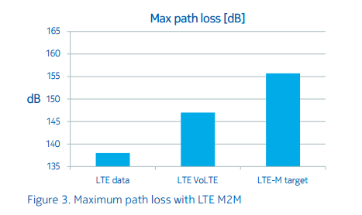
IOT power and link budgets
Release 12 Cat 0 eDRX dormancy up to 12.1 days but typically 2 minutes rather than standard 2.56 second DRX
Link budget improvements in LTE M2M delivered by reducing channel bandwidth (lower noise floor) - claimed to yield a 155 dB path loss compared to 147 dB for LTE VoLTE and 137 dB for LTE high speed data but some IOT will also be high data rate/low latency
Source Nokia http://resources.alcatel-lucent.com/asset/200175

Slide 31
EC-GSM Release13
Enhanced coverage variant of GSM
Uses additional channel coding (signal repetition) and signal combining to achieve a claimed 20 dB improvement over 900 MHz GPRS- advantage of much lower fully amortized device costs with relatively low patent costs- capacity/coverage trade off
Not efficient for higher data rate exchanges or for applications where devices are mobile or nomadic
Higher data rates need wider channels >5 MHz rather than 200 KHz GSM) to realise multiplexing efficiency
Increasing coding overhead reduces net throughput
eDRX incompatible with power control and handover algorithms for mobile applications
Operators being encouraged by vendors to decommission GSM – but beware safety critical IOT on GPRS

Slide 32
Verizon 5G Technology Forum
www.5gtf.org
Formed late 2015 with Cisco, Ericsson, Intel, LG, Nokia, Samsung and Qualcomm
Standards work for 28 and 39 GHz fixed access trials and deployments
Layers 1-3 defining the interface between the UE and the network
To be ready for the 2017 Super bowl (fortuitously stationary users – February 2017)

Slide 33
Verizon 5G Technology Forum
OFDM with cyclic prefix
QPSK,16 QAM and 64 QAM in the uplink and downlink
Single component carrier of 100 MHz (compared to 5 or 10 MHz for LTE) in a 1 GHz pass band
Resource bock spans 12 sub carriers with a sub carrier bandwidth of 75 KHz (compared to 15 KHz or 7.5 KHz for LTE) and a duration of 0.1 milliseconds (compared to 1 millisecond or 0.5 millisecond for LTE
Radio frame of 50 sub frames with a 10 millisecond frame length

Slide 34
Beam acquisition
UE acquires beams for downlink reception and uplink transmissions from beam reference signals (BRS)
UE performs Reference signal received power measurements (RSRP) on the reference signals and reports to the 5GNB (5G node B)
UE maintains a candidate beam set of 4 beams with beam state information measured and reported for each beam (beam reference received power)
Note detection of angular power likely to be a major RF front end performance challenge

Slide 35
AT&T
June 2016 3GPP agrees work plan for Release15 includes the development of a 5G New Radio (NR) physical layer and a timeline through June of 2018.
September 8 2016 Press release
LAS VEGAS – AT&T’s Thomas Keathley hopes 3GPP is able to speed up its work on the standard for 5G network technology so that the standard becomes available at the end of 2017 rather than in the middle of 2018, as currently scheduled.

Slide 36
AT&T and Verizon
AT&T and Verizon are working on 5G-like technology that they believe will eventually get worked into the standards.
They are not starting with a true mobile service, but with a fixed version that acts more like a home Internet connection.

Slide 37
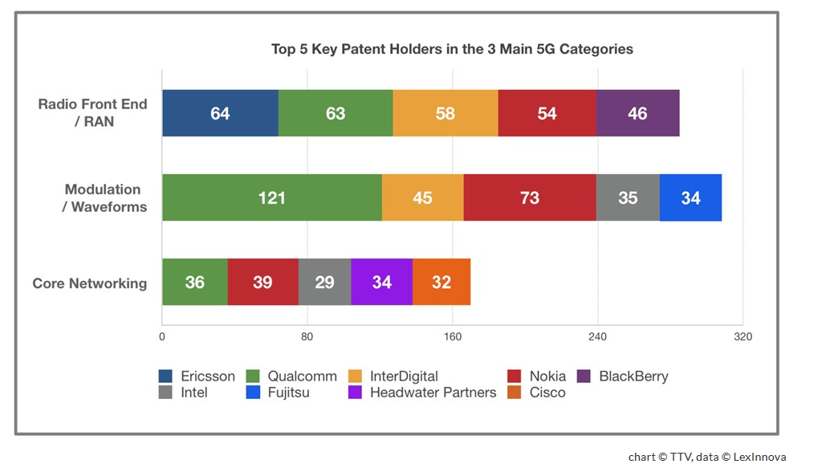
Patent value as the prize
1G | 2G | 3G | 4G | 5G
1980 | 1990 | 2000 | 2010 | 2020
1990 | 2000 | 2010 | 2020 | 2030
$2-3 million | $20-30 million | $200-300 million | $2-3 billion | $20-30 billion?
Includes RFIC NRE and directly associated RFFE costs including system support.
Royalty payments of $120 on a $400 Android or Windows smartphone, almost equal to the cost of device’s components. The largest two items are the cellular baseband and the Wi-Fi chip, each costing about $50 in royalty payments. (Source Intel)

Slide 38
Automotive radar spectrum and standards at 77 GHz
The 77 GHz automotive radar band consists of two sub bands, 76-77 GHz for narrow band long range radar and 77-81 GHz for short range wideband radar.
Compared to automotive radar at 24 GHz, 77 GHz radar provides better angular resolution due to the reduced spacing between antenna elements.
The higher carrier frequency means that the Doppler frequency increases proportionally relative to the velocity of the target which supports higher speed resolution.
Range resolution depends on the modulated signal bandwidth; the wider the bandwidth, the better the range resolution.

Slide 39
Automotive radar power outputs and spectral densities
Power outputs/spectral densities for 77 GHz pulsed and frequency modulated continuous wave (FMCW) radar are specified by ETSI for Europe and the FCC for the US.
For the FCC, the state of the vehicle determines the restrictions on allowed output power.
For a stationary vehicle, the spectral density in any direction must not exceed 0.2uW/cm² in any direction.
For a moving vehicle, the allowed spectral density is 60uW/cm² looking forward and 30uW/cm² for side looking and rear looking directions.
The maximum field strength determined by the FCC is 500uV/m at 3m distance equivalent to an EIRP power spectral density not exceeding -51.3dBm/MHz.

Slide 40
ETSI specifications
Regulatory authorities encouraging migration to the millimetre band by restricting emissions in the 24 GHz band- 24 GHz likely to be phased out over time at least in Europe
Table 2 ETSI Fixed antenna structure EIRP and OOB emissions for 77 GHz automotive radar
Band | 76-77 GHz
EIRP (FMCW) | 50 dBm (mean) | 55 dBm (max)
EIRP (Pulsed) | 23.5 dBm (mean) | 55 dBm (max)
3dB Beam width (Typical) | 5 degrees
Out of Band (OOB) emission | 73.5 -76 GHz | 0 (dBm/Hz)
 | 77-79.5 GHz | 0 (dBm/Hz)

Slide 41
Supply chain segmentation
Description | Sub 6 | Super 6 | Super 60?
Frequency | <6 GHz | 6- 60 GHz | > 60 GHz
 | Material, manufacturing and mathematical innovation
Channel bandwidth | 100 and 200 MHz | 250 and 500 MHz | 1 and 2 GHz
Four or five operator Pass band | 500 MHz -1 GHz | 1-2 GHz | 5-10 GHz

Slide 42
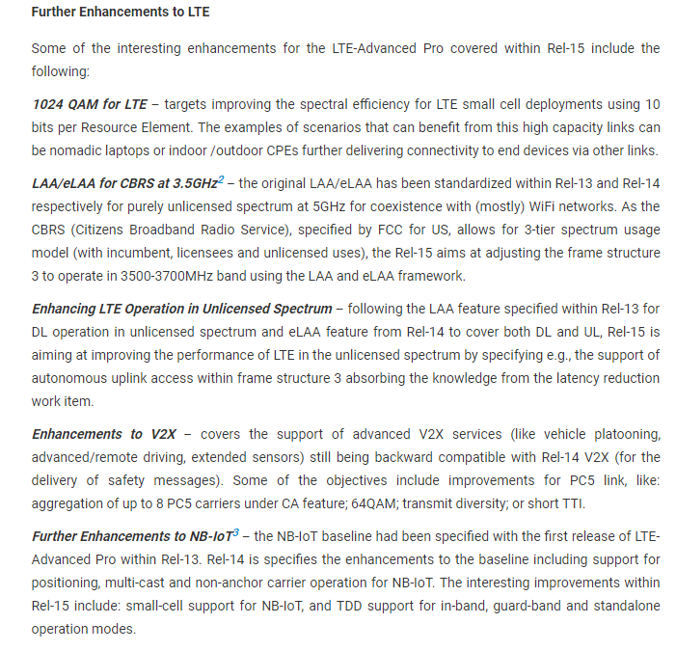
5G Release 15

Slide 43
5G Release 15

Slide 44
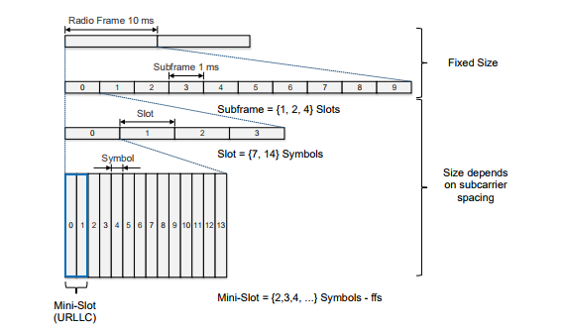
5G Sub carrier spacing and frame structure
Symbol and slot length scale with sub carrier spacing
Cyclic prefix lengths also dependent on slot length
Need to coordinate control signals and channels in time domain to avoid interference between LTE and NR

Slide 45
5G Mini slots
Mini slots needed for URLLC and for operation in unlicensed bands for example to start transmission directly after a successful listen before talk procedure without waiting for the slot boundary
Mini slots consist of two or more symbols – the first symbol includes uplink or downlink control information
Mini slots can be used for URLLC pre emption in eMBB

Slide 46
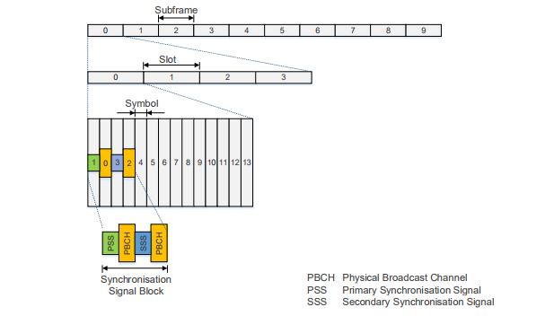
5G Synchronisation Signal Blocks
Synchronisation Signal Blocks

Slide 47
5G Physical block resources

Slide 48
5G Block bandwidths

Slide 49
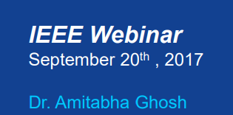
Nokia 5G

Slide 50
Nokia 5G

Slide 51
Nokia 5G

Slide 52
Nokia 5G

Slide 53
Nokia 5G

Slide 54
Nokia 5G

Slide 55
Nokia 5G

Slide 56
Nokia 5G

Slide 57
Nokia 5G

Slide 58
Nokia 5G

Slide 59
Nokia 5G

Slide 60
Nokia 5G

Slide 61
Nokia 5G

Slide 62
Nokia 5G NR Beam Based Air Interface

Slide 63
Nokia 5G NR

Slide 64
Nokia 5G NR

Slide 65
Nokia 5G NR

Slide 66
Nokia 5G NR

Slide 67
Nokia 5G NR

Slide 68
Nokia 5G NR

Slide 69
CPRI

Slide 70
CPRI Common Public Radio Interface
CPRI specification defines the criteria for interfacing transport, connectivity and control communications between the BBU and RRU. Specification V.0 published by the IEEE in 2003
It is not a standard. Each radio equipment OEM encodes a unique adaptation of the specification to provide processing efficiencies unique to their hardware.
In the distributed antenna system (DAS) marketplace, system vendors traditionally have not been able to interface their equipment directly with base station systems using the CPRI protocol.
Instead, the DAS interface used analogue radio frequency (RF) processing, remote radio heads for amplification, stacks of signal manipulation panels and complex cabling networks.
HARQ (Hybrid automatic repeat high-rate forward error-correcting coding and ARQ error-control.
64 QAM LTE modulated directly onto RF signal on fibre
HARQ budget for LTE is 3 ms with 2 ms as a target (5G target of 1 ms)
CPRI consumes part of that budget with D/A, A/D processing, coding and framing.
By eliminating CPRI, the total processing time is shortened but fibre dispersion/scattering of the signal adds delay
Every 10 micro seconds saved in processing adds 1 km of fibre reach.
As processing speeds and algorithms improve, it may be possible to have front haul reach out to 100 km (1ms)
http://www.commscope.com/Blog/CommScope-Definitions-What-Is-CPRI/

Slide 71
OBSAI
http://www.obsai.com/

Slide 72
RF over Fibre
Highly linear fibre optic transceiver with IIP3 > 35 dBm
Operating at noise level of -160dB/Hz
71 km RF over Fibre LTE-Ultra transmission links
Five 20 MHz intra-band aggregated carriers for a total of 100 MHz
3% Total EVM (rms) for 64QAM modulation.
Meets ≤ 8% requirement for 64QAM set in 3GPP specification 36.104 for signal transmission between base station and remote radio head.
CPRI/OBSAI transmission layer can be eliminated and replaced with higher bandwidth, lower cost lower power direct RF over Fibre LTE transmission.
Implemented using wavelength division multiplexing
Solution for implementing next generation 5G front haul Cloud Radio Access Networks
http://www.apichip.com/rfof-5-lte-advanced-carriers-70km/

Slide 73
Nokia 5G NR

Slide 74
802.11ax Qorvo White paper
https://vertassets.blob.core.windows.net/download/7d705b86/7d705b86-8245-42b2-a160-863d22a8d720/802_11ax_5_things_to_know.pdf

Slide 75
802.11ax Qorvo White paper

Slide 76
802.11ax Qorvo White paper

Slide 77
802.11ax Qorvo White paper

Slide 78
802.11ax Qorvo White paper

Slide 79
802.11ax Qorvo White paper

Slide 80
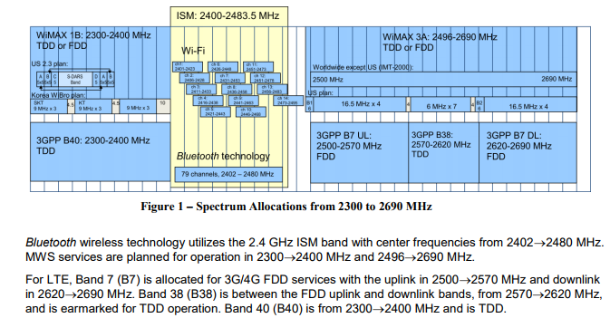
802.11ax and Bluetooth BLE

Slide 81
Bluetooth BLE for IOT the 5.0 spec

Slide 82
Bluetooth BLE for IOT the 5.0 spec
5.0 introduces high power (20 dBm/100 milliwatt) BLE for long distance (1600 metre range).
This is used with additional error coding.
This means that high power 20 dBm BLE could be coexisting with 0dBm BLE or -20 dBm BLE or in special cases -30 dBm ‘whisper mode’ BLE.

Slide 83
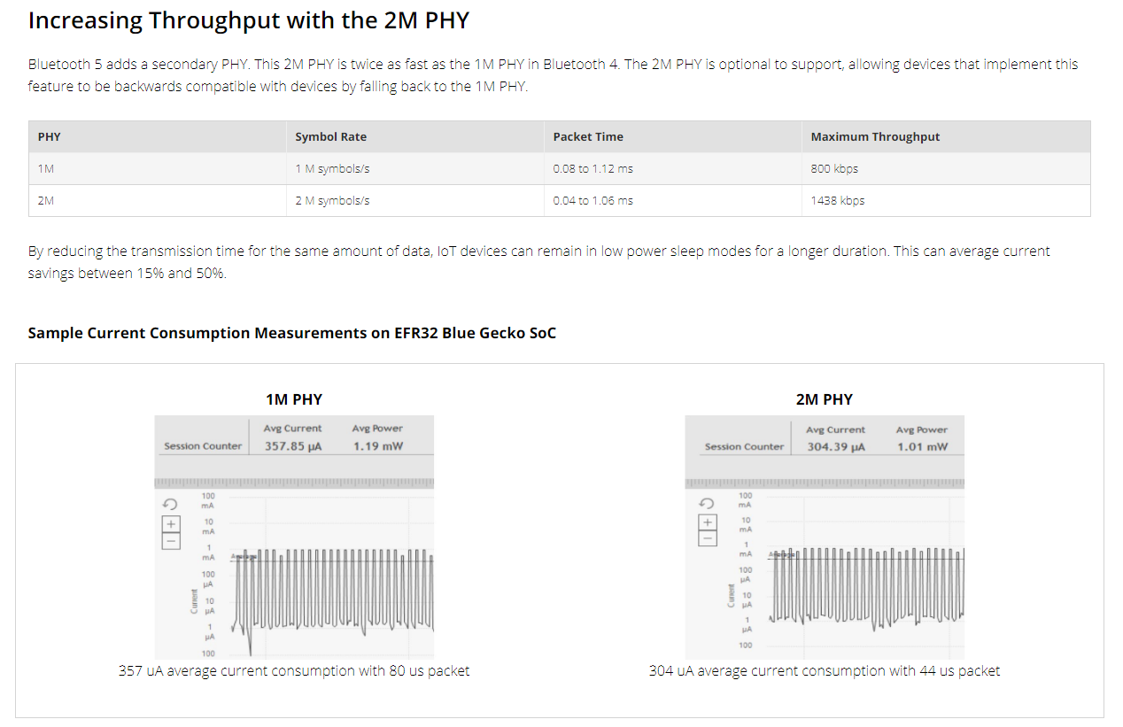
Bluetooth 5.0 2M PHY
.
http://www.silabs.com/products/wireless/learning-center/bluetooth-5

Slide 84
Bluetooth 5.0 Stable Modulation index

Slide 85
Bluetooth 5.0 Stable Modulation index
Note these devices may need to work over extended temperature ranges
Grade 1 -40°C to +125°C ambient operating temperature range or -40°C to +105°C (Grade 2) ambient operating temperature range.

Slide 86
Bluetooth 5.0 Power outputs
Note these devices may need to work over extended temperature ranges

Slide 87
Bluetooth Mesh
There are a number of choices of connection topology including point to point, star or mesh.. However a failed node can compromise the integrity of the whole system.
Mesh protocols can reduce RF power requirements but any gains can be offset by protocol overheads (mesh can be a chatty protocol).
There are mesh protocols specified for 802.15.4, 802.11n and BLE.
IVT Wireless, a Chinese vendor, and Mind Tree, an Indian vendor, were first to market with a BLE mesh protocol product offer.
Note these devices may need to work over extended temperature ranges

Slide 88
Other IOT systems for Sub 1 GHz IOT

Slide 89
5G Waveforms
FBMC, Filter Bank Multi-Carrier: similar to CP-OFDM, OFDM using a cyclic prefix which is used as the 4G waveform. Instead of filtering the whole band as in the case of OFDM, FBMC filters each sub-carrier individually. FBMC does not have a cyclic prefix and as a result it is able to provide better spectral efficiency but incurs more processing head (spectral versus power efficiency trade off).The subcarrier filters are narrow and require long filter time constants. Typically the time constant is four times that of the basic multicarrier symbol length and as a result, single symbols overlap in time. To achieve orthogonality, offset-QAM is used as the modulation scheme
UFMC, Universal Filtered Multi Carrier: An enhancement of CP-OFDM. It differs from FBMC in that instead of filtering each subcarrier individually, UFMC splits the signal into a number of sub-bands which it then filters. UFMC does not have to use a cyclic prefix, although one can be used to improve the inter-symbol interference protection.
GFDM, Generalised Frequency Division Multiplexing: GFDM is a flexible multi-carrier transmission technique with similarities to OFDM. The main difference is that the carriers are not orthogonal to each other. GFDM provides better control of the out-of-band emissions and reduces the peak to average power ratio, PAPR.
Filtered OFDM, f-OFDM The bandwidth available for the channel on which the signal is to be transmitted is split into several sub-bands. Different types of services are accommodated in different sub-bands with the most suitable waveform and numerology. This enables a better utilisation of the spectrum for the variety of services to be carried.

Slide 90
5G and satellite co existence – 5G modulation options

Slide 91
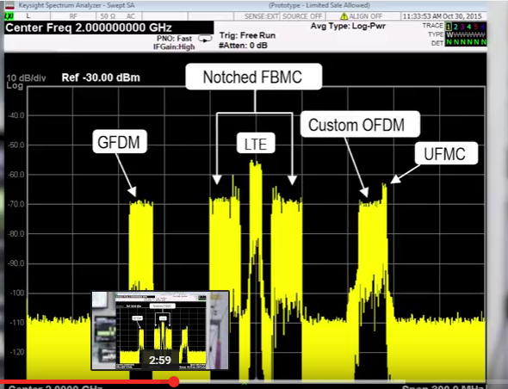
Sub 6 GHz Release 15 LTE and 5G Coexistence

Slide 92
Sub 6 GHz Technology Mix

Slide 93
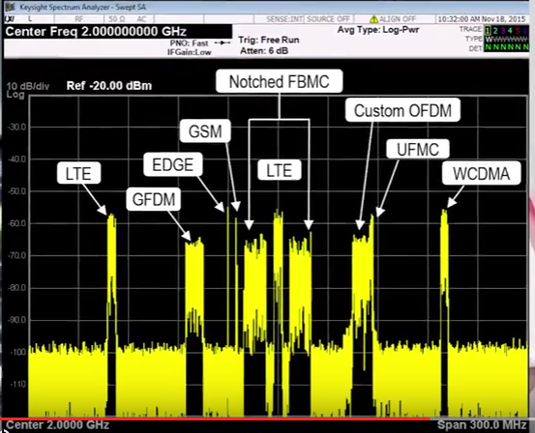
Sub 6 GHz Technology Mix and channel bandwidth

Slide 94
Sub 6 GHz 5G and 4G EVM

Slide 95
5G and satellite 28 GHz Co existence satellite APSK

Slide 96
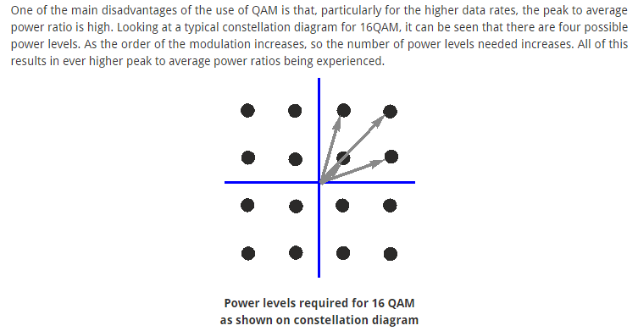
5G QAM
http://www.radio-electronics.com/info/rf-technology-design/quadrature-amplitude-modulation-qam/what-is-qam-tutorial.php

Slide 97
Satellite APSK
http://www.radio-electronics.com/info/rf-technology-design/apsk-amplitude-phase-shift-keying/what-is-apsk-tutorial.php

Slide 98
Satellite APSK
With thanks to Keysight Technologies

Slide 99
5G at 71-76 GHz
With thanks to Keysight Technologies

