Slide 1
Satellite production and manufacturing

Slide 2
Production innovation in satellites

Slide 3
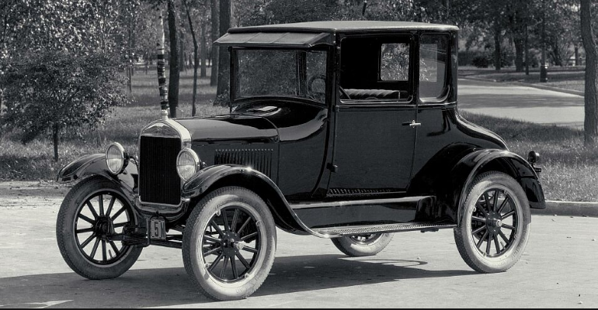
The 5G story
Ford Model T 1907
Rifle manufacturing and watch making and abattoirs
Materials innovation -Light weight vanadium steel
Manufacturing innovation- close tolerance engine components
Production innovation- meat hook production line
Faster, further (fuel efficient), lower cost

Slide 4
110 years later The Tesla Production Line
Freemont California

Slide 5
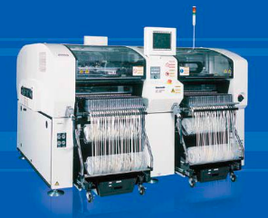
The equivalent smart phone production line
Panasonic Pick and Place Machine
Light head, high-speed recognition camera and linear motor.
100,000 components per hour
Component capability from 0402 (01005) chips to 90 x 100mm on up to 18" x 20" boards

Slide 6
Tape machines and mass production
Scale is needed in order to invest in manufacturing technology in order not to compromise component performance in order not to compromise product performance
This is particularly important for RF active and passive components at higher frequencies and for high performance static sensitive memory products

Slide 7
Tesla Gigafactory Nevada

Slide 8
Tesla Solar Panel factory Buffalo New York

Slide 9
Tesla Cars
Ford produce 6.6 million cars a year and make a profit on every car
Ford has an enterprise value of $46 billion dollars
Tesla produce 120,000 cars a year and make a loss on every car
Tesla has an enterprise value of $48 billion dollars

Slide 10
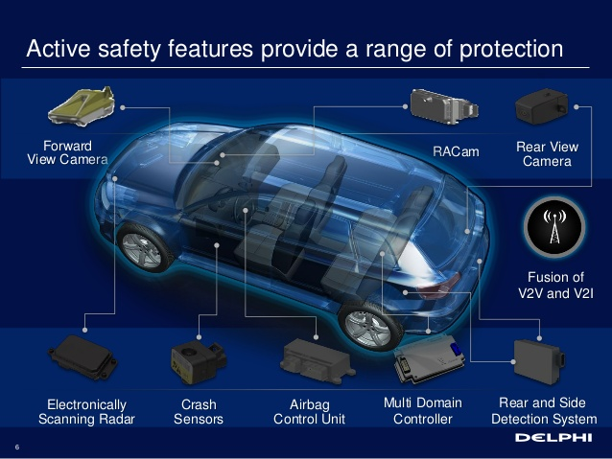
Automotive radar
5G and autonomous space applications

Slide 11
5G and Satellite Industry Supply Chain
Two million satellite customers globally
>Four billion mobile phone customers

Slide 12
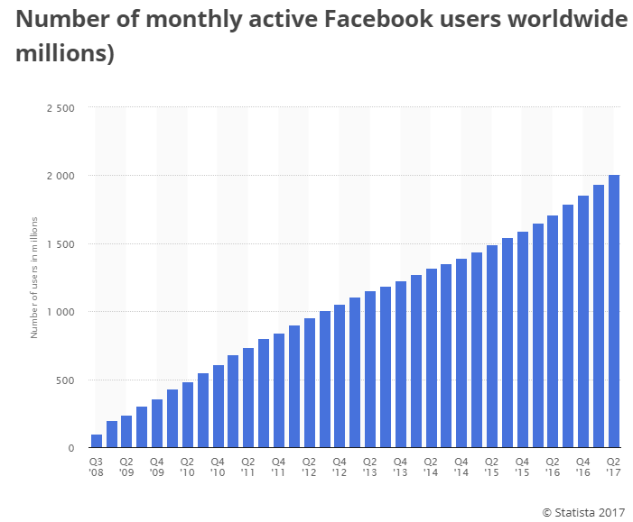
THE GAFA QUARTET
Google G Mail > one billion users
https://www.statista.com/topics/1001/google/
Facebook 2 billion users
https://www.statista.com/statistics/264810/number-of-monthly-active-facebook-users-worldwide/

Slide 13
THE GAFA QUARTET
Amazon
65 million prime users
http://uk.businessinsider.com/amazon-gives-clue-number-of-prime-users-2017-2
Apple 588 million users, 1 billion devices (1.7 devices per user)
http://uk.businessinsider.com/credit-suisse-estimates-588-million-apple-users-2016-4

Slide 14
PAYPAL Registered user accounts
https://www.statista.com/statistics/218493/paypals-total-active-registered-accounts-from-2010/

Slide 15
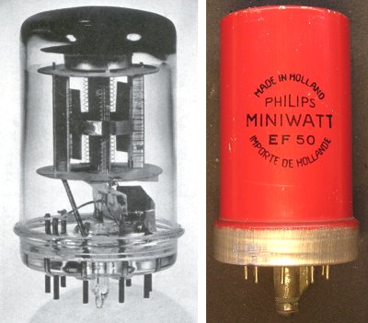
1940-45 TV and radar and radio

Slide 16
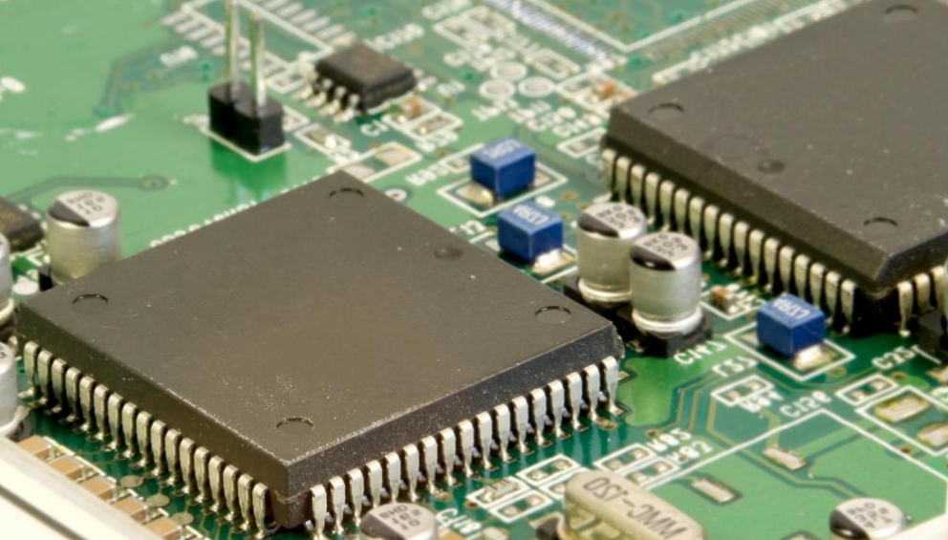
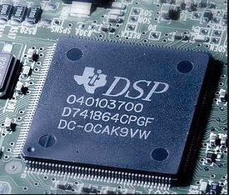
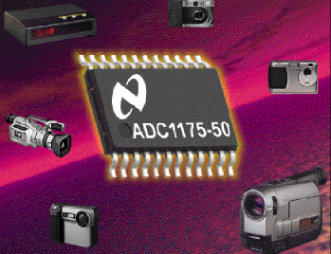
1945 onwards- transistors, micro controllers,DSP, ADC

Slide 17
Forty Years of RF development 1977 The BC ERA

Slide 18
Forty Years of RF development 1987
8 hours to manufacture and test a cell phone

Slide 19
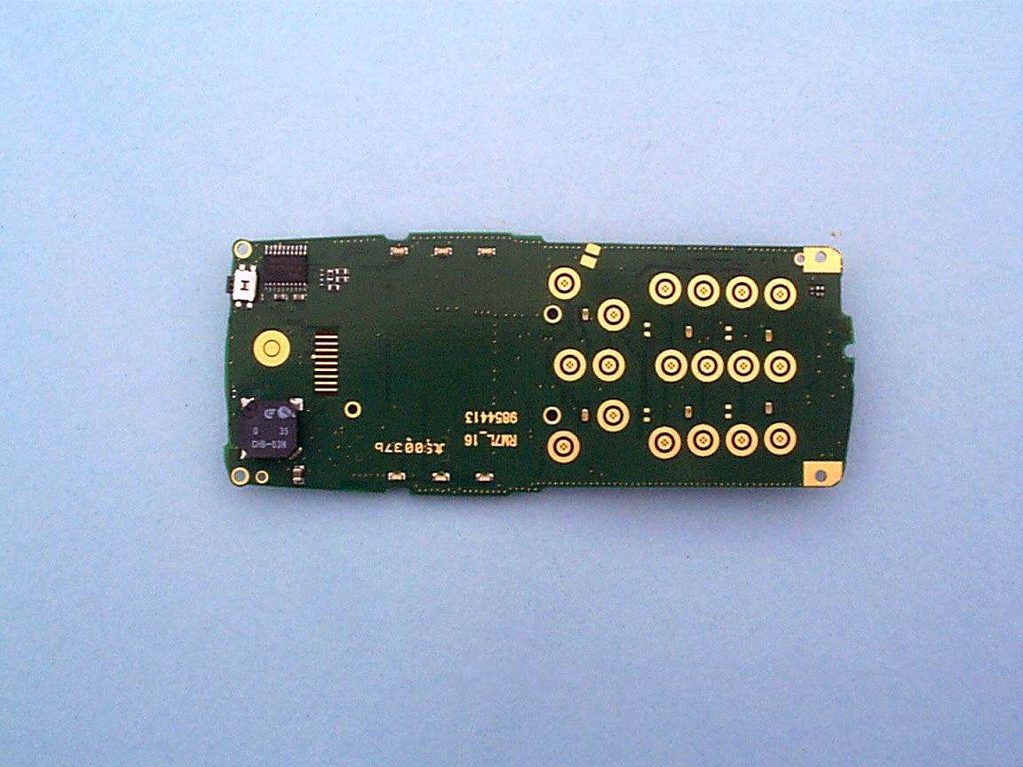
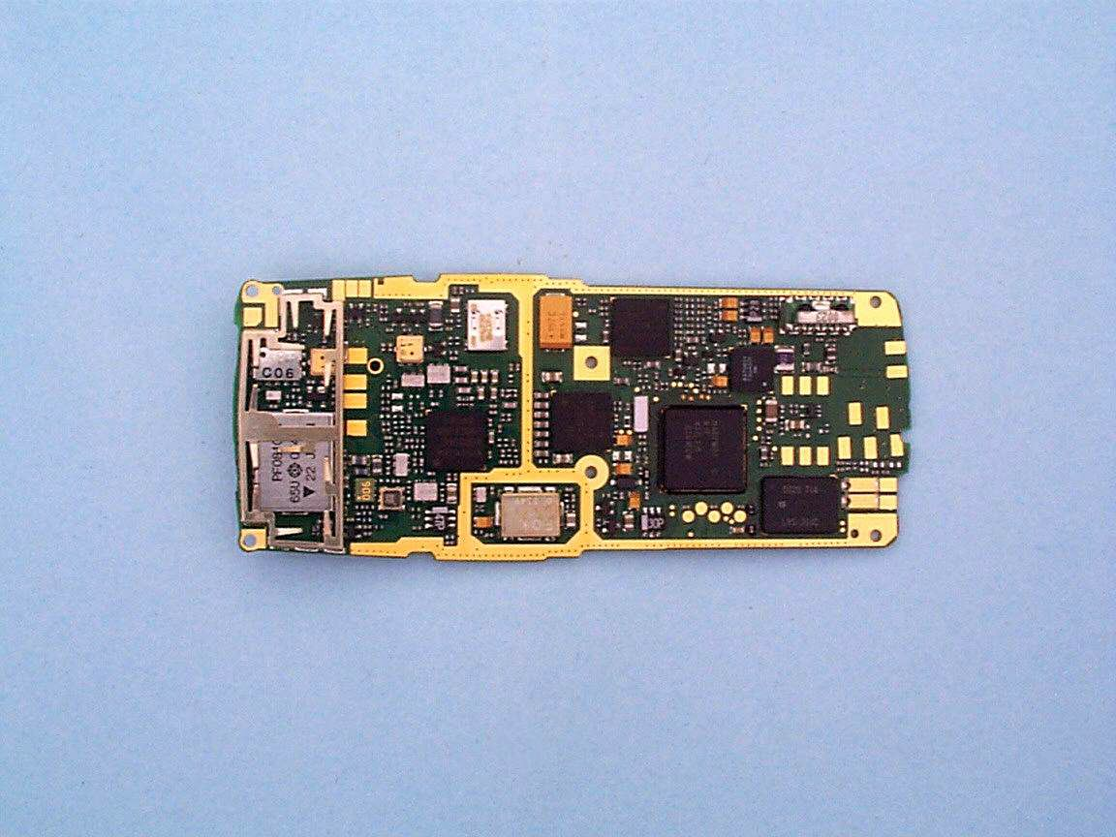
Forty years of RF development GSM
1992-2002 ten years of GSM
Manufacturing time measured in minutes
Nokia owned the components in the phone for under a minute

Slide 20
Forty years of RF development 2007-2017

Slide 21
Will the ESIM change everything

Slide 22
Will the ESIM change everything?
Apple Watch Series 3 with eSIM
An example of how financial fire power (Apple cash) can be translated into device innovation that in turn is dependent on innovative material and manufacturing techniques.
LTE connectivity in the device is achieved by using the screen as an antenna; the device is water resistant to 50 metres and includes a barometric altimeter and GPS receiver and power optimised Wi-Fi and Bluetooth (the battery needs to last all day for the device to be useful).
Some of the satellite pass bands for example in L band and S band are adjacent to LTE spectrum but it will be hard to motivate smart phone manufacturers, particularly the two largest manufacturers by volume and value (Apple and Samsung) to extends existing pass bands or add another switch path both of which will add cost and compromise performance particularly in products like the Apple Watch where space and energy consumption are at a premium.
This would only be justifiable if Apple or Samsung had a direct fiscal interest in adding satellite connectivity

Slide 23
Component Supply chain segmentation
Description | Sub 6 | Super 6 | Super 60?
Frequency | <6 GHz | 6- 60 GHz | > 60 GHz
 | Material, manufacturing and mathematical innovation
Channel bandwidth | 100 and 200 MHz | 250 and 500 MHz | 1 and 2 GHz
Four or five operator Pass band | 500 MHz -1 GHz | 1-2 GHz | 5-10 GHz

Slide 24
RF Component Materials Innovation
Gallium nitride for power amplifiers
Four times the power output of gallium arsenide for the same size transistors
GaN MMIC at 150 nm gate lengths for >40 GHz point to point links
Issues of wafer cost (yield), packaging and memory effects
Expensive semi insulating silicon carbide substrates
Lower cost but lower performance GaN on silicon
Surface roughness of copper on printed circuits becomes an issue
Stray capacitance effects
Memory effects (trapping) over time constants from milliseconds to seconds
Abrupt changes in signal gain following high output power events – problem for base stations with bursty traffic

Slide 25
RF Component Materials Innovation
Power amplifiers in point to point microwave operated in Class AB to support 4096 QAM modulation
Max output power for a GaAS MMIC is 40 dBm (10 watts) at 10 GHz
Falls to 26 dBm (400 milliwatts)at 86 GHz (E band)
Efficiency is 35% at 10 GHz, 15% at 86 GHz
Note also issues of test and measurements - cabling and connectors

Slide 26
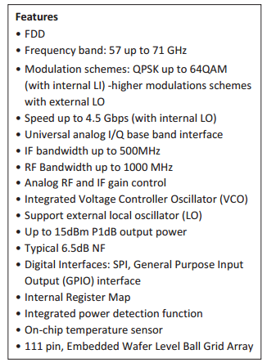
RF Components for 60 GHz

