Slide 1
Satellite Technology and market innovation
Propulsive power and processing power - 5G goes nuclear?.
The birth of the satellite industry sixty years ago only made possible by advances in component technology including the transistor in the early 1950’s, the microcontroller in the 1970’s; the digital signal processor in the 1980’s and low cost high performance memory in the 1990’s.
The combination of these innovations is opening up a host of new space based opportunities including servers in the sky, above the cloud computing and new dot.space business models.
These new satellite constellations will co share spectrum with existing MEO and GSO satellites. They achieve this through angular power separation which requires the satellites to roll as they fly towards the equator (progressive pitch control).
Could angular power separation enable co sharing with satellite Ka band spectrum including the 28 GHz band?

Slide 2
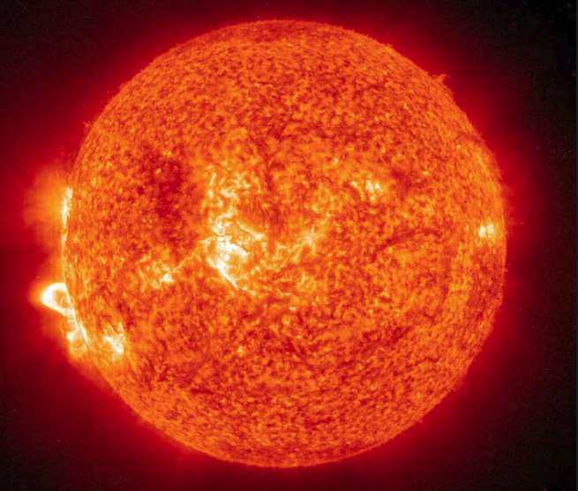
The Sun as a source of power
Close to earth, in LEO, MEO and GSO orbits, there is sufficient sunlight to power most communication satellites. Solar energy is measured in W/m2, energy per unit area.
Outside the Earth's atmosphere this is roughly 1,350 W/m2. On the Earth's surface this is a maximum of around 1,000 W/m2 for extreme desert areas. In addition on Earth there are night and day cycles, so there is more solar energy in space (it’s official - it’s sunnier in space).

Slide 3
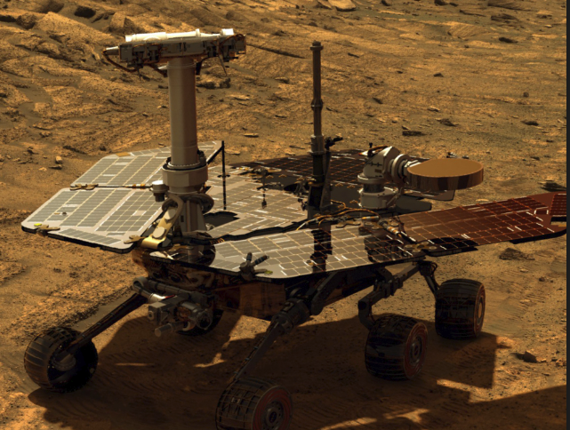
Solar panels in space
Consumer grade solar panels that you may have at home typically have an efficiency of 15%.
Solar panels for use in space use optimized manufacturing techniques based on germanium rather than silicon with cells that have multiple p-n junctions that capture different portions of the energy spectrum.
These panels can achieve efficiencies approaching 30%
The systems also depend on the ability to manufacture space qualified cover glass to protect large arrays of solar panels from impact damage.
The Opportunity Mars Land Rover has just finished 11 years exploring the surface of the planet from the original landing sight. The original expectation was that the solar panel arrays would not survive for longer than 90 days. The solar panel supplier for many of these deep space projects (Spectrolab) is a subsidiary of the Boeing Corporation

Slide 4
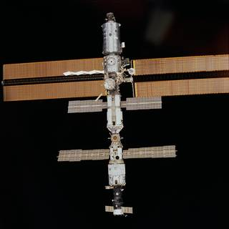
The International Space Station
The poster child of large solar arrays is the International Space Station orbiting in a LEO orbit at 350 kilometres with four sets of solar arrays each 33 metres long and over 12 metres wide producing 200 kilowatts of electricity. Together the arrays contain a total of 275,0000 solar cells and cover an area of about 2,500 square meters, more than half the area of a football field.

Slide 5
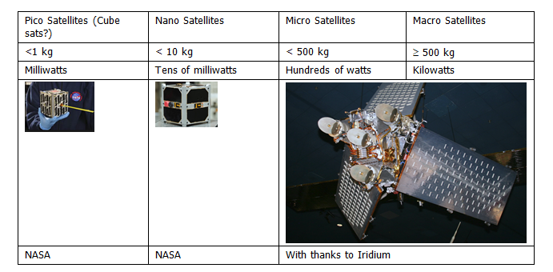
Satellite Power requirements

Slide 6
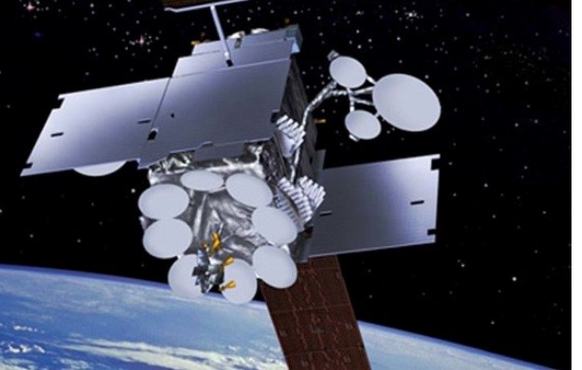
Inmarsat GSO
The Inmarsat Ka-band GSO satellites have solar panel arrays with a wing span of 33.8 metres with ultra-triple-junction gallium arsenide solar cells that generate 15 kW of power at start of service and 13.8 kW by end of life (15 years). The panels also power the xenon ion propulsion system. The body is the size of a double decker bus with a launch weight of 6,000 kg. Eighty nine Ka-band user beams are generated by two transmit and receive aperture antennas with an additional six steerable on-demand spot beams.

Slide 7
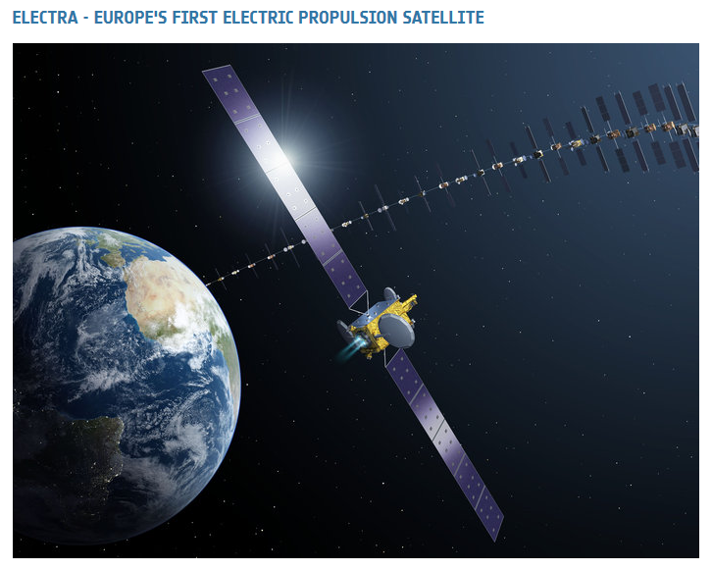
Ion thrusters in space- electric satellites
Orbit raising and longer orbit life

Slide 8
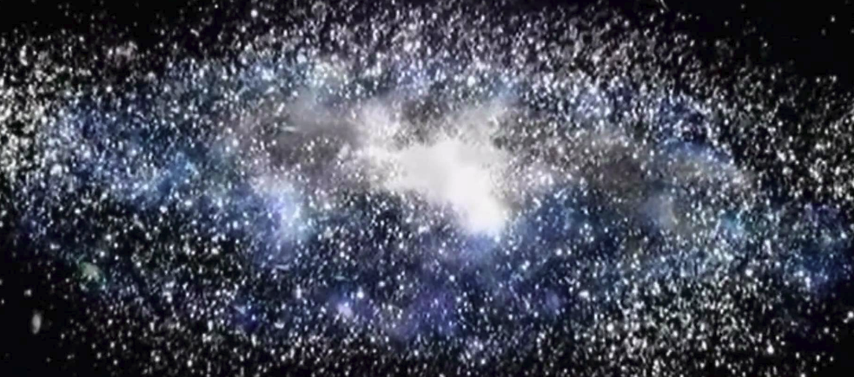
What happens when the sun stops shining?
Decay heat from Radioactive isotopes (thermo- electric generation)
Fission (replicating the Sun by splitting atoms)
Fusion (replicating the birth of the universe 13 billion years ago by fusing atomic matter together under extreme pressure
The best option depends on the amount of power needed, the time scale over which it is required, the amount and type of gamma rays or x or y ray ionising radiation produced and the cost and complexity of containing that radiation
And the available nuclear power plants

Slide 9
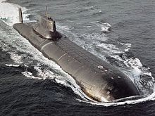
The nuclear option
VMF Typhoon Class Submarine- Nuclear Powered and the world’s largest displacement submarine

Slide 10
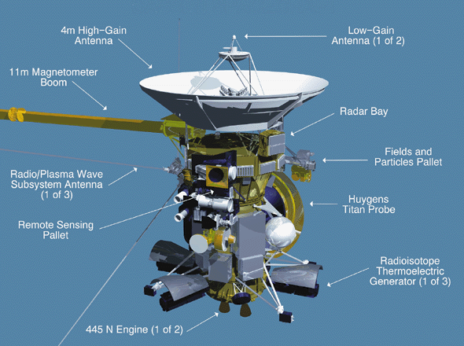
The calculated risk of radiation
When the Cassini-Huygens probe was launched in 1997 the United States Department of Energy estimated the chances of a launch accident that would release radiation into the atmosphere at 1 in 350, It was estimated that a worst-case scenario of total dispersal of on-board plutonium would spread the equivalent radiation of 80% of the average annual dosage in North America from background radiation over an area with a radius of 105 kilometres

Slide 11
What happens when the sun stops shining?
Radio-isotopes have been used in space as a heat and power source for over fifty years and are known as RTG’s, Radio-isotope Thermo-electric Generators. When used just to warm up they are known as RHU’s (Radio-isotope Heating Units).
Plutonium, specifically Plutonium-238 (Pu-238) has been widely used partly because it has been available as a by-product of the US and Russian and other country weapon programmes. It has a decay heat of -0.56 watts per gram and a half-life of 88 years. A typical RHU used to warm instruments to an efficient operational temperature would typically use just under 3 grams in a box about 3cm by 2.5 cm to produce a watt of power.
There are also many by-products of plutonium including Americium, produced when plutonium is bombarded with neutrons for example in a reactor or weapons test. Americium-241 is the most common flavour of Americium, manufactured from ageing plutonium stocks
Americium is significantly less expensive to manufacture. The cost of manufacturing a kilogramme of plutonium has been estimated as $8 million dollars. The European Space Agency is paying for AM-241 recovered from the UK’s civil plutonium stocks where this cost has essentially been amortised over many years of (expensive) nuclear power generation. The cost is therefore high but already paid for by the UK tax payer.

Slide 12
What happens when the sun stops shining?
For several decades there has been enough plutonium available from civil and military nuclear programmes including for example from the various nuclear missile reduction programmes for space use either in its raw state or processed into AM-241.
In 2011, NASA and the US Department of Energy received $10 million of US tax payer funding to restart plutonium production with the intention of generating initially 1.5 kilogrammes per year at significantly lower cost.
Throughout the 1990’s the US bought Pu-238 from Russia, in total about 16.5 kilograms, a by-product of START, the Strategic Arms Reduction Treaty and Glasnost.
When President Putin came to power, Russia decided it would no longer be a source of supply hence the focus on US based production capability.
Plutonium is produced by irradiating Neptunium-237, a radioisotope with a half-life of just over two million years.
Russian RTG’s are apparently still operational in orbit on Cosmos navigation satellites launched in 1965. China’s lunar lander apparently uses Pu-238 based RTG’s.

Slide 13
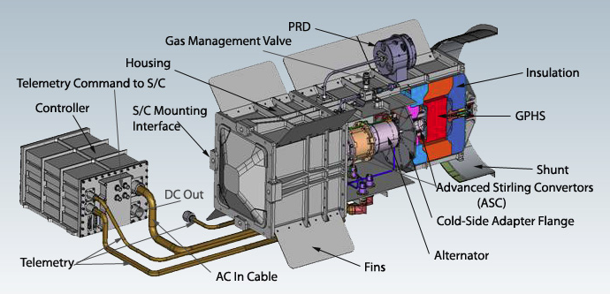
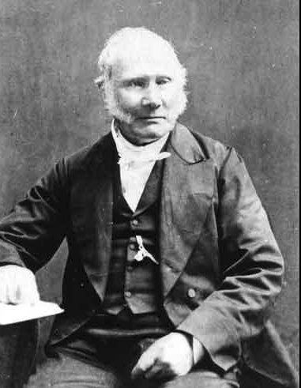
Stirling and Brayton cycle engines
Used to convert heat into electricity
Invented in 1817 by the Reverend Robert Stirling(1790-1878)

Slide 14
Going nuclear- thermal rockets
Russia has used over 30 fission reactors in space; the USA has flown only one - the System for Nuclear Auxiliary Power in 1965.
From 1959-73 there was a US nuclear rocket programme – Nuclear Engine for Rocket Vehicle Applications (NERVA) working on using nuclear power rather than chemical power for the latter stages of launches.
NERVA used graphite-core reactors heating hydrogen and expelling it through a nozzle. Some 20 engines were tested in Nevada and yielded thrust up to more than half that of the space shuttle launchers.
Generally it was felt that this would be altogether two hazardous for earth band mortals and the focus shifted to propulsion in space. A $19 million dollar contract has been placed by NASA with specialist nuclear energy company, BWXT Nuclear Energy Incorporated, to study the feasibility of a nuclear thermal rocket.
In 1958, the US Project Orion planned to launch a 1000 tonne spacecraft using a series of nuclear explosions.
The project was stopped in 1958 by General Atomics when the Atmospheric Test Ban Treaty made it illegal.
Russia however pressed on with fission reactors for space using uranium carbide fuel at high temperature.
Used to convert heat into electricity
Invented in 1817 by the Reverend Robert Stirling(1790-1878)

Slide 15
Why is uranium cheaper than plutonium
Because you can dig it out of the ground.
There are three major fissile isotopes, Uranium 235, used in the Hiroshima bomb and most nuclear power reactors, Uranium 233 used in Thorium reactors but not in weapons and Plutonium 238.
The first nuclear weapons used uranium because plutonium had to be manufactured by neutron bombardment and to make plutonium you need a lot of neutrons and the only realistic way of getting these is a uranium based fission reaction.
Plutonium has more energy density than Uranium and it is easier to get plutonium to a critical mass than uranium.
For weapons systems this is an advantage but for a communications satellite energy source probably a disadvantage.
And plutonium produces lots of alpha radiation rather than beta or gamma radiation
Of the three types of ionising radiation, alpha is the least penetrating while gamma is the most penetrating.
However plutonium gets into humans via the bloodstream via the lungs then keeps going into our bones, liver, and all other vital organs where it can stay for decades before it kills us, though if the dose is big enough it can kill us alarmingly quickly.
When alpha rays get into our cells they cause between 10 and 1,000 times more chromosomal damage than beta or gamma rays. Polonium, also a by-product of Uranium, has similarly devastating medical effects particularly when added to tea.

Slide 16
The regulation of nuclear space
The regulatory issues associated with nuclear powered satellites are dealt with by the Office for Outer Space Affairs (UNOOSA) under the administration of the United Nations. UNOOSA implements policy decisions taken by the Committee on Peaceful Uses of Outer Space (COPUOS) set up in 1959 and now supported by 75 member states.
http://www.unoosa.org/
http://www.unoosa.org/oosa/en/ourwork/copuos/2017/index.html

Slide 17
Space power options
GSO Solar Array | Radioisotope Thermoelectric Generators | Stirling or Brayton Cycle Engines | Proton Exchange Membrane Fuel Cells
30 metre span solar panels produce 15 kilowatts reducing to 12 KW at end of life (15 years) | Milliwatts to Watts to kilowatts (General Purpose Heat Source Modules) Simple thermocouple No moving parts 100% reliable 50 year life | 4 times better conversion efficiency than RTG’s 500 watts of thermal power=140 watts of electric power from a kilogramme of Pu-238 oxide 15 year life? | Efficient non-radioactive option High energy weight ratio Can be shared with propulsion system Liquid hydrogen and liquid oxygen Water as a by product 10,000 hour service life (1-2 years)

Slide 18
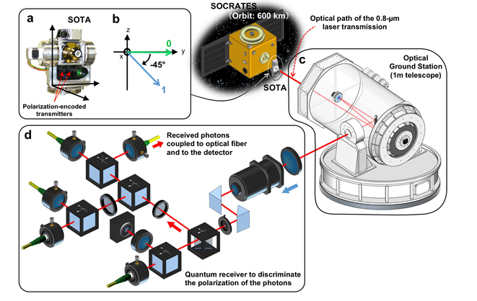
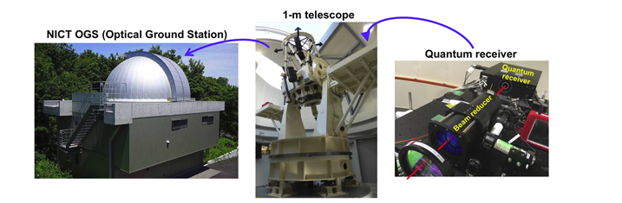
Quantum computing using optical transceivers

Slide 19
Quantum computing using optical transceivers
Japan’s National Research and Development Agency (NICT) have developed what they claim is the world’s smallest and lightest quantum communication transmitter on board the micro satellite SOCRATES
The satellite weighs 6 kilogrammes and is 17.8 centimetres in length, 11.4 centimetres wide and 26.8 centimetres high.
The satellite transmits a laser signal to earth at a rate of 10 million bits per second form an altitude of 600 kilometres at a speed of 7 kilometres per second.
The project is targeted at producing an ultra-secure communications network.
https://www.nict.go.jp/en/about/

Slide 20
Uranium in the news
The LIGO and VIRGO gravitational wave detectors have detected gravitational wave energy generated by the merging of two neutron stars.
This followed the first detection of a gravitational wave from two collapsing black holes. These events are now calculated to happen every 15 minutes somewhere in the Universe
Merging neutron stars are a source of the heaviest chemical elements on earth including uranium, platinum and gold.
The merging of the neutron stars was coincident with flashes of visible light detected by a combination of earth and sky based telescopes (NASA Fermi and ESA Integral).
A gamma ray burst was detected two seconds after the gravitational wave. It all happened 130 million light years away in the constellation Hydra.
Neutron stars are the remains of large stars whose cores have collapsed producing a tiny ball of immensely dense neutrons. A thimble full of neutron star is the equivalent of a small mountain in weight.
Two neutron stars colliding either produce a single larger neutron star or depending on their temperature and spin speed and mass, a black hole. The gamma ray burst and flash of light indicates that this latest measurement was a merging of two neutron stars (gamma rays and light rays would not normally escape from a black hole).
The events also have a different wave signature. Merging black holes produce a wave that is observable for a fraction of a second. When two neutron stars merge, the gravitational waves are observed for about a minute.
The mysteries of gravitational waves, first predicted in 1916 by Albert Einstein, may see remote to the present day reality of 5G and satellites but these discoveries mark a significant advance in our understanding of energy and its nuclear origin and radiation characteristics
https://www.livescience.com/60695-why-gravitational-wave-discovery-matters.html?utm_source=notification

