Slide 1
Constellation innovation

Slide 2
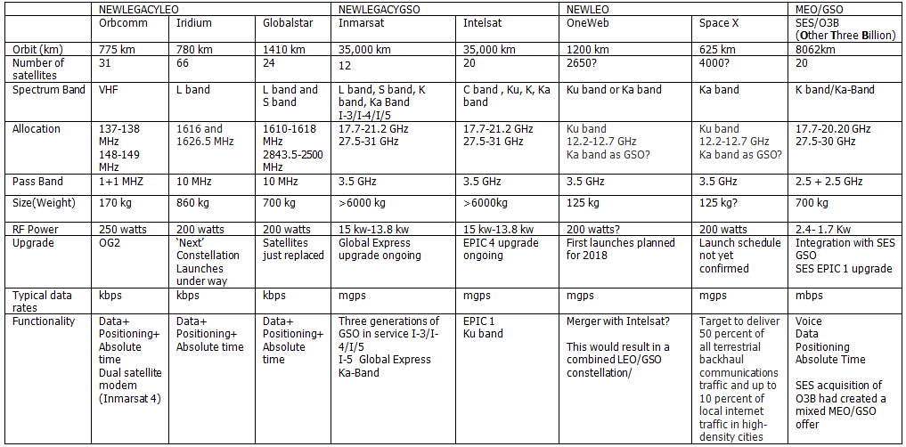
Legacy and new constellations

Slide 3
8000 LEOS ?
Iridium | Globalstar | Sky Space Global | OneWeb | Space X | Leo SAT | Boeing
L Band | L and S band | UHF, L and S band | Ku and Ka Band | Ku and Ka Band | Ka Band | V Band and C Band
78 LEOS | 24 LEOS | 200 LEOS | 650 LEOS | 4000 LEOS | 78 LEOS | 2956 LEOS
780 km | 1414 km | 500-800 km | 1200 km | 1200 km | 700 km | 1200 km
860 kg | 700 kg | 10 kg (Cube SAT) | 200 kg | 100-500 kg | 860 kg | ?

Slide 4
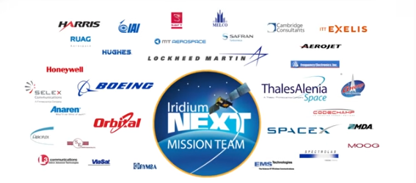
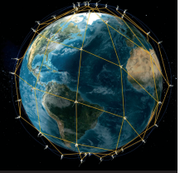
Iridium Next (L band)
January 14, 2017– the first payload of ten Iridium Next satellites launched and deployed into low-Earth orbit (LEO) by Space X
First of seven launches over the next 15 months - 10 per launch - largest ever slot swop
Includes real time global aircraft tracking (includes polar orbits)

Slide 5
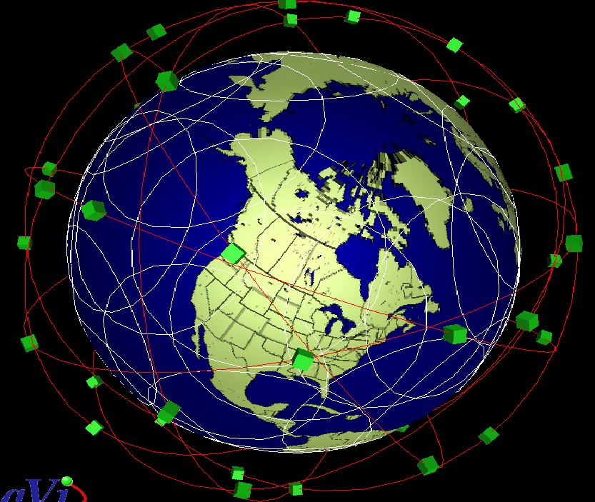
Globalstar (L band and S Band SAT FI)
December 2016, the FCC adopted rules permitting Globalstar to deploy a terrestrial low-power broadband network using 11.5 MHz of the Company's 2.4 GHz (S band) spectrum.(TDD LTE adjacent to Band 7)
Supports small cell deployment for LTE networks Also has L band transponders
Six replacement satellites in 2013 256 kbps rather than 9.6 kbps
8 planes, 3 satellites each; 114-minute orbit 70 S to 70 N latitude coverage; minimum two satellite coverage in temperate zones High signal quality and availability – dynamic power control for changing conditions, coherent combining increases signal strength Bent-pipe architecture – provides low latency and enhanced service quality
15 year life expectation (first generation 7 years)
Hughes Networks +Ericsson

Slide 6
Globalstar

Slide 7
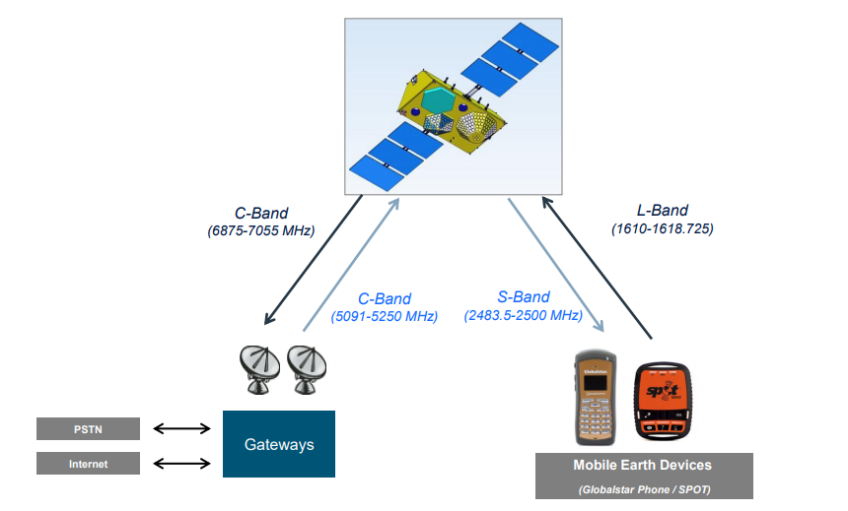
Globalstar
Band 7 FDD Mob TX 2500-2570 Mob RX 2620-2690 MHz
Band 41 TDD 2496-2690 MHz (194 MHz)
5 GHz Wi-Fi

Slide 8
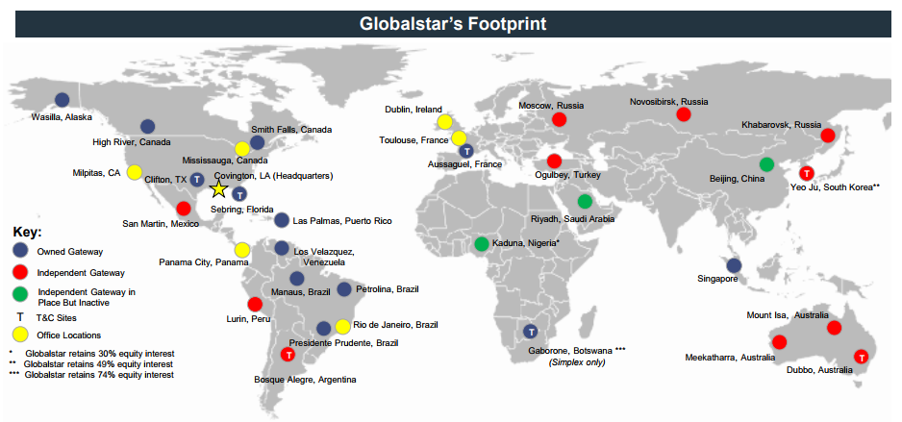
Globalstar

Slide 9
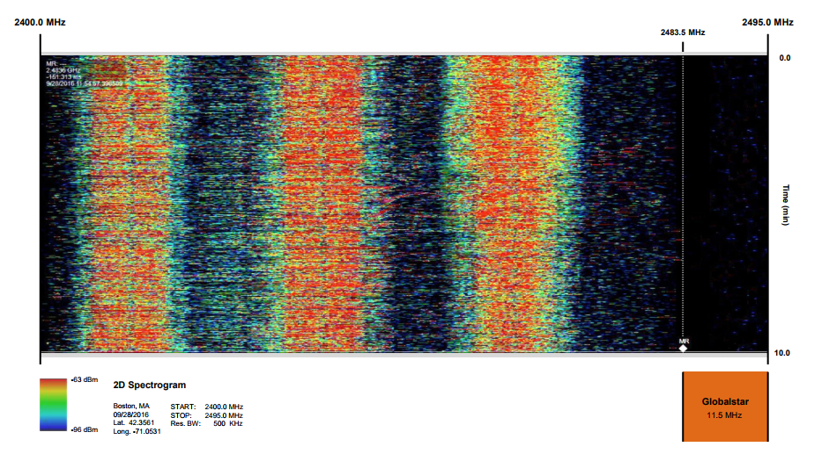
Globalstar
11.5 MHZ allocated under Part 25 rules- full interference protection from adjacent services

Slide 10
Globalstar and the 5 GHz Wi-Fi Band?
Globalstar 5091-5250 MHz
Note potential in band interference issues with 5 GHz Wi-Fi and out of band interference issues with 2.4 GHz Wi-Fi (S band adjacency).

Slide 11
Globalstar – devices and RF hardware
Globalstar S Band | Band 7
 | Mob TX FDD | Mob TX/RX TDD | Mob RX FDD
2483.5-2500 MHz | 2500-2570 MHz (70 MHz) | 2570-2620 (50 MHz) | 2620-2690 MHz (70 MHz)
 | Band 41
 | 2496 | 190 MHz including guard band | 2690
Inmarsat same scale issue with Band 1 adjacency

Slide 12
Globalstar

Slide 13
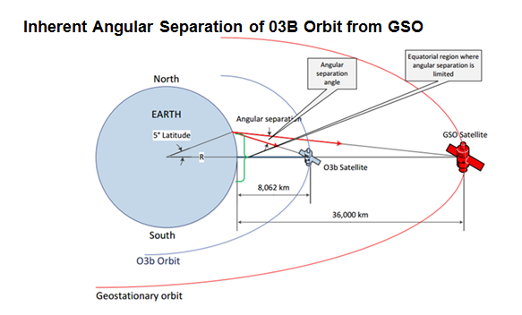
Constellation innovation- SES/O3b
Angular power separation
30,000 formed beams system wide
12 satellites in MEO (8 more in 2018)
50 satellites in GSO
Digicel and Singtel as customers
Coverage of +/- 50 degrees latitude for nearly 400 million km²
Full global coverage possible via inclined planes
1gbps trunking for 5G

Slide 14
Constellation innovation- SES/O3b
With thanks to SES

Slide 15
Constellation innovation- SES/O3b
With thanks to SES

Slide 16
OneWeb

Slide 17
New LEOS OneWeb Ku and Ka Band
One Web Earth Stations
50 proposed gateway earth stations with four are deployed in the USA including Hawaii and Alaska.
The gateway earth stations will also transmit and receive control channels for satellite payload control and gateway link power control.
A subset of gateway sites in high latitude regions of the world will provide telemetry tracking and command (TT and C).
There will be at least two separate satellite control centres, probably in Virginia, USA and the UK with network operations controlled from the UK and Melbourne, Florida.
Payload control transmissions to and from the US gateway earth stations will take place in the band edges just below 19.3 GHz (downlink) and just above 27.5 GHz (uplink).

Slide 18
OneWeb Ku and Ka Band
Satellite Beams
Each OneWeb satellite will have 16 nominally identical user beams, operating in Ku band, each consisting of a non-steerable highly elliptical spot beam. There are also two identical steerable gateway beam antennas operating in Ka band. Each of these antennas creates an independently steerable circular spot beam. The second beam tracks the next gateway earth station for handover procedures.
While the Ku band user beams cannot be steered, the Ku band footprint can be moved up and down in latitude. OneWeb call this Progressive Pitch. The attitude control system of each satellite allows the pointing of the satellite to be adjusted so the beam pattern can be moved in the pitch direction (north to south). The power output from each beam can also be controlled and adjusted to meet EIRP and flux density country specific regulatory requirements.
The movement of the satellites in their orbits means that a user will be progressively handed over from beam to beam within a OneWeb satellite and then handed off to the beams on the next satellite in the same orbital plane or adjacent plane.

Slide 19
OneWeb Ku and Ka Band
Each user beam supports services to multiple user terminals. In the forward direction (gateway to user) there is a TDM transmission scheme within a single 250 MHz channel.
Each user terminal in the beam receives and demodulates the whole carrier and extracts only the data destined for it which is determined by the data headers (and potentially also the position in the TDM transmission?).
In the return direction (user to gateway) there is a Single Carrier TDMA/FDMA transmission scheme modulated on to a relatively narrow band carrier (1.25 MHz to 20 MHz wide).
On the basis of 720 satellites, every point on the earth’s surface will see at all times a OneWeb satellite at an elevation of no less than 55 degrees with increasing minimum elevation with latitude.

Slide 20
New LEOS OneWeb Ku and Ka Band
650 LEO constellation or 2000 LEOS?
Satellites mass manufactured in a purpose built factory
One billion dollars of funding from Softbank (who also own Sprint and ARM)
Paul Jacobs and Richard Branson (Virgin Galactic) on the board
Active power tilting capability to minimise interference with (higher up) GSO constellations

Slide 21
New LEOS OneWeb Ku and Ka Band

Slide 22
Definition of the avoidance angle

Slide 23
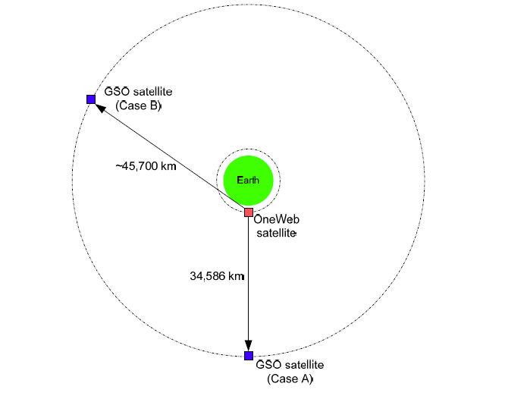
Difference in path length from OneWeb to GSO

Slide 24
New LEOS OneWeb Ku and Ka Band
The ITU PFD limits applicable to NGSO systems in the 10.7 to 11.7 GHz band can be found in Table 21.5 of the ITU radio regulations and are effectively the same as the FCC PFD limits.
The OneWeb FCC filing documents their methodology for calculating maximum EIRP density for all angles of arrival and departure across the Ku, K and Ka band pass bands taking into account the spreading loss from the satellite to the surface of the earth (i.e. the variation in signal strength over the elliptical area illuminated).
OneWeb review their methodology for demonstrating compliance with the FCC and ITU EIRP and PFD limits established to minimise interference to GSO systems and their methods for calculating interference from GSO satellites into the OneWeb network including other mechanisms such as power control which are used to deliver constant flux density at different elevation angles.
Note that lower elevation angles will absorb more RF power and will therefore reduce the capacity of the constellation which in turn reduces the technical and commercial efficiency of the constellation. These technical details and the interference and coexistence assumptions behind these technical details determine the economic viability of the business model.
Progressive pitch takes place gradually as the satellite passes through mid-latitudes to lower latitudes. As the satellites pass over the equator they temporally turn off RF power and then adjust their pitch to the opposite direction.

Slide 25
New LEOS - Space X Ku and Ka Band
FCC filing for 83 different orbital planes ranging from 715 miles (1,150 kilometres) to 790 miles (1,325 kilometres) at inclinations from 53 to 81 degrees. Initial constellation of 1,600 satellites and a final deployment of an additional 2,825 spacecraft. Coverage in the Ka and Ku bands for approximately five years. Elon Musk

Slide 26
The technical and legal challenge
ABS Presentation 2015
Cable and Satellite Broadcasting Association
http://www.casbaa.com/
Asia Broadcast Satellite Ku band satellite TV
http://spacenews.com/oneweb-gets-slide-decked-by-competitor-at-casbaa/

Slide 27
The technical and legal challenge

Slide 28
The technical and legal challenge

Slide 29
The technical and legal challenge

Slide 30
The technical and legal challenge

Slide 31
The technical and legal challenge

Slide 32
The technical and legal challenge

Slide 33
The technical and legal challenge

Slide 34
Mixed constellations as the answer
Mixed constellations= GSO+MEO+LEO+5G
Technical benefits – changes the global user experience by exploiting the capabilities of AES antennas – consistent east to west north to south coverage for fixed and mobile users and fixed and mobile gateways- power efficiency. Spectral efficiency and cost efficiency benefits
Commercial benefits- overcomes the problem of system to system interference litigation
But requires a substantial change to competition policy, regulatory policy and spectrum allocation and auction policy

Slide 35
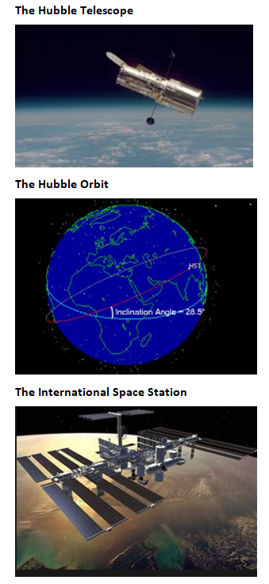
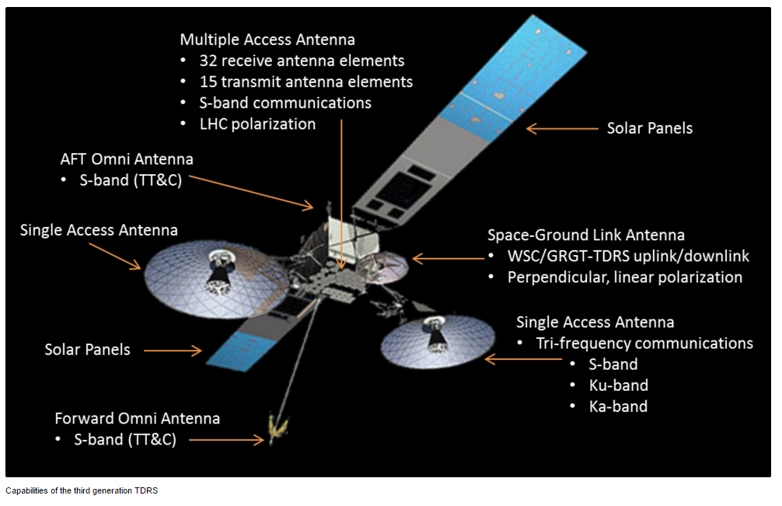
Existing examples of mixed constellations
Near earth network and TDRS
Tracking Data and Relay System
NEWLEOS such as OneWeb will need to coordinate with NASA to guarantee protection of TDRSS in the 14.0 to 14.2 GHz band and with space observatories operating radio astronomy services in the 10.6 to 10.7 GHz band and with US government satellite networks, both GSO and NGSO in Ka band.

Slide 36
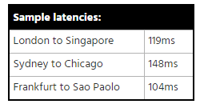
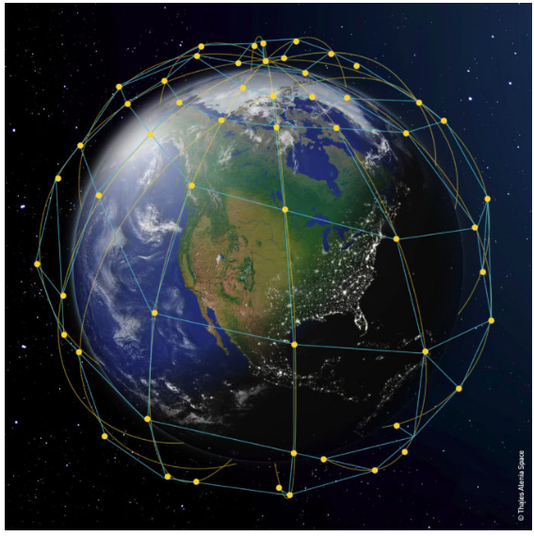
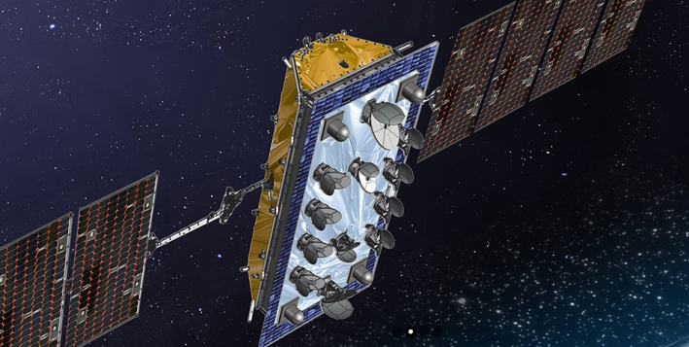
New LEOS – LEOSAT ‘Faster than Fibre’
Light travels faster in free space than it does in a fibre optic cable
Once a fibre optic cable reaches a certain length (about 5,500 km), LEOS start to have lower latency – free space speed advantage outweighs the round trip distance (1400 kilometres)
Same space approach as Iridium (both use Thales)- 78 satellites

Slide 37
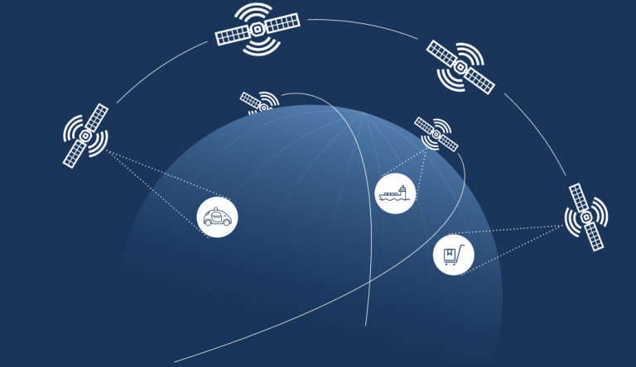
New LEOS – Eighty LEO (Kaskila)
200 kg satellites – European project focus
Vertical market IOT - automotive, aviation, infrastructure, mining & construction, agriculture, maritime, health care
Competing with Orbcomm? (OG2 via Space X – VHF)

Slide 38
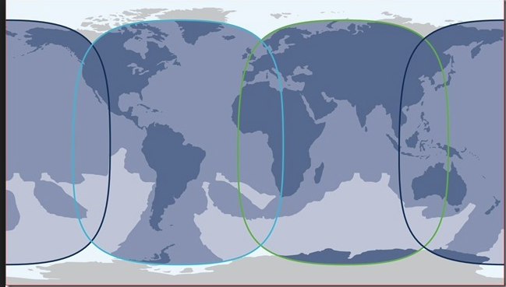
GSO Innovation - The International SATS
The Global SATS – 4 or more satellites (Inmarsat example)

Slide 39
The International SATS INTELSAT
The pictures from the Moon landing in 1969 were sent round the world via Intelsat GSO satellites.
Intelsat was privatised in 2001 two years after Inmarsat. This coincided with the dot com bust, the telecoms meltdown (Nortel going bankrupt) and the global fibre glut. In 2006 Intelsat acquired Pan Am SAT becoming the world’s largest fixed service satellite service provider. It has constellation assets in C band, Ku and Ka band.
Intelsat provide an alternative to Inmarsat from a Ku-band constellation and launched the first of a new generation of six satellites in January 2016 via Europe’s Ariane 5 heavy lift rocket. The new satellites weigh over 6,500 kilograms and are positioned to cover the Caribbean and North Atlantic cruise routes (and land mass as well). The satellites are manufactured by Boeing. Failed merger with OneWeb.

Slide 40
The International SATS EUTELSAT KaSAT
Eutelsat was formed in 1977 to operate the first European satellites (launched in1983).
After the fall of the Berlin Wall, Eutelsat was extended to cover Eastern Europe. It was privatised in July 2001 and went through an IPO in 2005.
TV still represents a substantive part of Eutelsat’s income, broadcasting to the Middle East, Turkey and Africa from the Hot Bird satellites.
In January 2014, Eutelsat acquired SATMEX (Mexico) which effectively means the company provides providing coverage of Europe, Africa, the Middle East, Asia and the Americas.
The EUTELSAT 7C electric satellite is scheduled to launch in the third quarter of 2018. The satellite will have 44 Ku-band transponders and will be co-sited at 7° East position for Turkey and Sub Saharan Africa doubling the number of transponders from 22 to 42 over Sub Saharan Africa.
This means that Eutelsat will be offering capacity from more than 40 satellites. This represents a big share of the available geostationary orbit slots (even taking into account co-siting).
http://www.eutelsat.com/en/services/data/consumer-broadband/tooway.html
Initial Public Offering

Slide 41
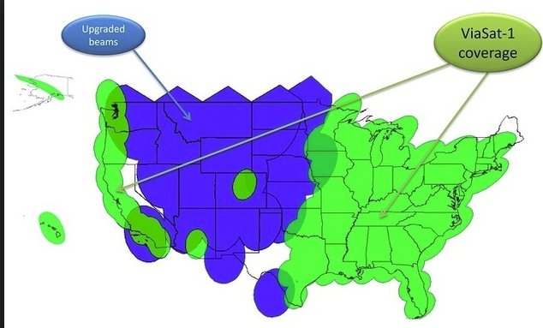
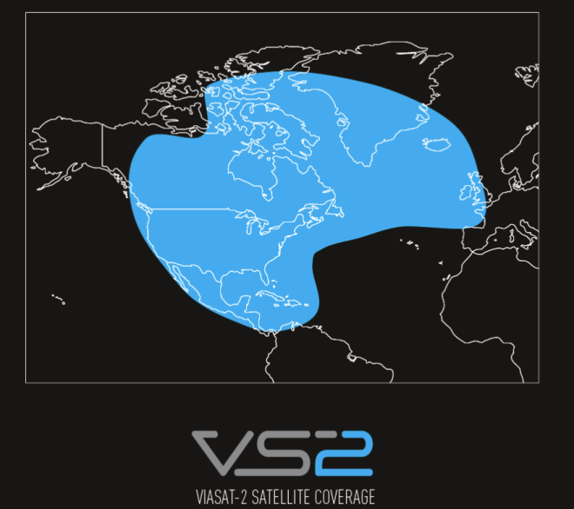
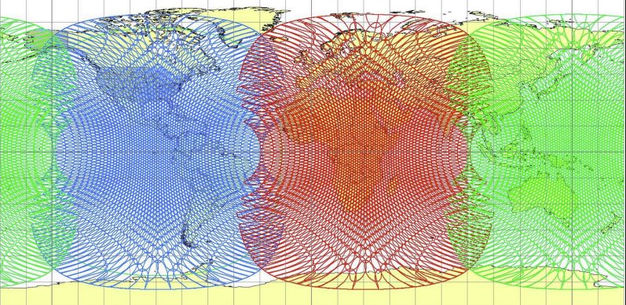
Viasat 1+2+3
Viasat 3

Slide 42
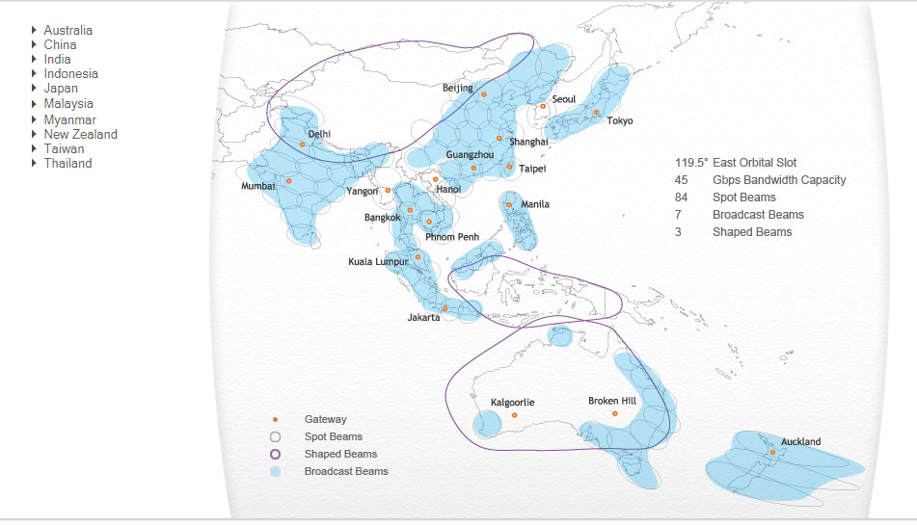
The Regional SATS IPSTAR
4 satellites

Slide 43
The Regional SATS ARABSAT

Slide 44
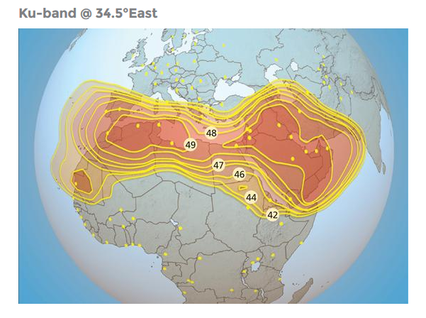
The Regional SATS ARABSAT

Slide 45
The Regional SATS ARABSAT

Slide 46
The Regional SATS HISPASAT

Slide 47
Regional SATS Hylas Avanti

Slide 48
The Sovereign SATS
SATS often start with a country specific implementation plan
Canada, US,
Telesat
Telesat, a Canadian company that wants to repurpose its GSO TV satellites and couple them to a LEO constellation. The target market is cellular extension, broadband innovation and high latitude communication.
Boeing?
Boeing Corporation V band proposal at 51.4 - 52.4 GHz and 37.5 - 40 GHz based on a (presumably Boeing proprietary) common baseband between a GSO and LEO constellation with an optional C band extension (satellite primary status in C band was restated at WRC 2015).
https://www.telesat.com/
http://spacenews.com/boeing-proposes-big-satellite-constellations-in-v-and-c-bands
Brazil, India, Indonesia, China, Iran, Israel

Slide 49
The Sovereign SATS Australia NBN 2 satellites

Slide 50
The Sovereign SATS USA Jupiter 2

Slide 51
VHTS satellite spectrum at WRC 2019
32 GHz Band (31.8-33.4 GHz)
Potential for international harmonisation as it was proposed for study by all three ITU regions at WRC-15
Similar propagation characteristics as other lower mmWave bands, but less present or planned use
Q-/V-Bands (37-52 GHz)
GSO plans to deploy next-generation VHTS in Q and V bands
Six global non-GEO constellations: Boeing, O3b, OneWeb, SpaceX, Telesat and Theia - WRC-19 Agenda Item 9.1.9 seeks additional uplink spectrum for future VHTS systems

Slide 52
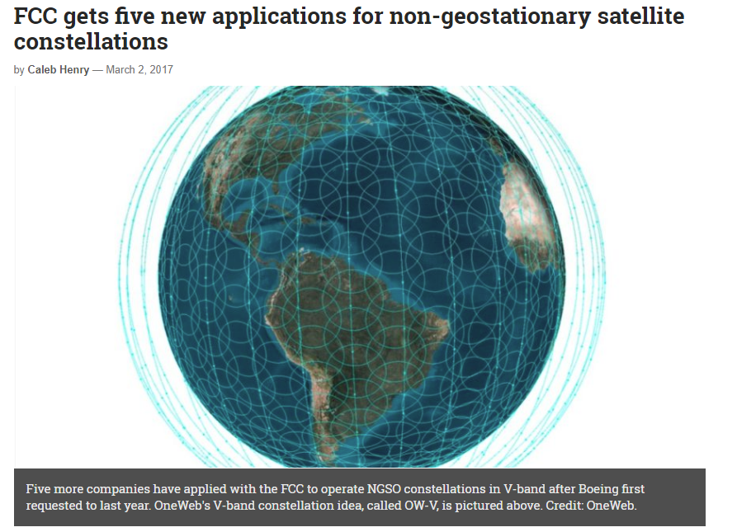
VHTS satellite spectrum at WRC 2019
SpaceX, OneWeb, Telesat, O3b Networks and Theia Holdings submissions to the FCC for V-band satellites in non-geosynchronous orbits to provide communications services in the United States and elsewhere.
Boeing submission to use 37.5 to 42.5 GHz range of V-band for downlinking from spacecraft to terminals on Earth, and 47.2 to 50.2 GHz and 50.4 to 52.4 GHz) for uplinking back to the satellites using 1,396 to 2,956 low-Earth orbit (LEO) satellites .
SpaceX proposes a “VLEO,” or V-band low-Earth orbit (LEO) constellation of 7,518 satellites to follow the operator’s initially proposed 4,425 satellites that would function in Ka- and Ku-band. Canada-based Telesat describes its V-band LEO constellation as one that “will follow closely the design of the Ka-band LEO Constellation,” using 117 satellites not counting spares as a second-generation overlay. Theia asked the FCC to allow it to use V-band frequencies for gateways on the ground that would have originally only used Ka-band. OneWeb wants to operate a “sub-constellation” of 720 LEO V-band satellites at 1,200 kilometres, and another constellation in Medium Earth Orbit (MEO) of 1,280 satellites expanding the OneWeb constellation by 2000 satellites. Traffic would be dynamically assigned between the LEO and MEO V-band constellations based on service requirements and the data traffic within coverage areas.
OneWeb’s application for MEO follows that of ViaSat’s in November for 24 MEO satellites to augment Viasat 3, the company’s trio of terabit-per-second-throughput satellites currently underway. Viasat bundled its request for use of V-band together with its application for MEO Ka-band. O3b wants market access to V-band for up to 24 additional satellites that would operate in a circular equatorial orbit as a constellation called O3bN

Slide 53
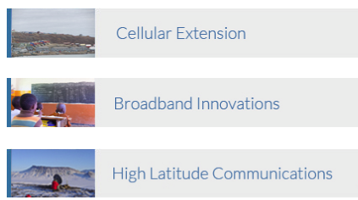
New LEOS -TeleSAT
Canadian Based Company
Background in TV delivery from GEO satellites – adding LEOS to create a hybrid constellation

Slide 54
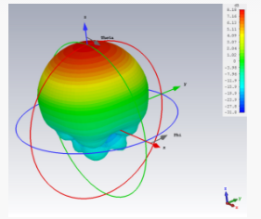
Sky and Space Global (SAS) Cube Sat
Initially 15 degrees north to 15 degrees south
UK registered company
2016 raised $4.5 million in capital and began trading on the Australian Securities Exchange.
First three satellites launched as a piggy back with ISRO
Follow on agreement with Virgin Galactic

Slide 55
Sky and Space Global

Slide 56
Sky and Space Global (AMOS)

Slide 57
Sky and Space Global (SAS)

Slide 58
Sky and Space Global
https://www.skyandspace.global/investors/investor-presentation/

Slide 59
Sky and Space Global

Slide 60
Sky and Space Global

Slide 61
Sky and Space Global

Slide 62
SAS Spectrum
Sky and Space Global's constellation is planned to use spectrum in the S band and L band for mobile communication coverage, S band for inter-satellite links and S band and UHF for mission control
On 27 September 2016 the company announced that it has received approval from the United Kingdom's Ministry of Defence to use its UHF frequencies for command and telemetry of the three demonstration satellites until the end of 2019 with the possibility to extend this timeframe
Through Ofcom, the United Kingdom’s communications regulatory body, Sky and Space Global gained approval to use S-band spectrum from the International Telecommunications Union(ITU).

Slide 63
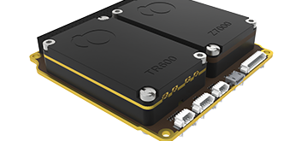
Gomspace L band and S band transceivers

Slide 64
Gomspace

Slide 65
Gomspace

Slide 66
Gomspace

Slide 67
Gomspace

Slide 68
Gomspace

Slide 69
Gomspace

Slide 70
Space Sensing- Planet Labs
https://www.planet.com/

Slide 71
Space Sensing- Planet Labs
https://www.planet.com/
https://theredddesk.org/what-redd

Slide 72
GNSS
GPS satellites fly in medium Earth orbit (MEO) at an altitude of 20,200 km
Each satellite circles the Earth twice a day. Enlarge. Expandable 24-Slot satellite constellation, as defined in the SPS Performance Standard.6 Jun 2017
GPS.gov: Space Segment
www.gps.gov/systems/gps/space/

Slide 73
Glonass and GPS
https://beebom.com/what-is-glonass-and-how-it-is-different-from-gps/

Slide 74
Glonass and GPS

Slide 75
Other systems

Slide 76
Other systems

Slide 77
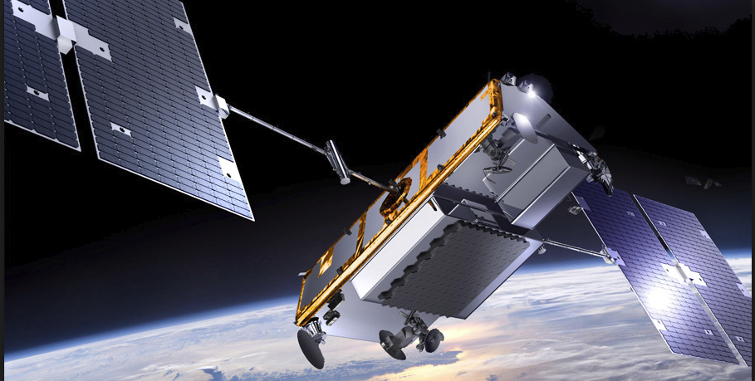
Positioning from LEO constellations
May 23, 2016
Iridium Launches Breakthrough Alternative Global Positioning System (GPS) Service Satellite Time and Location (STL) Solution Enables Positioning, Timing and Authentication to Augment GPS Technology for Critical Applications
High Doppler signature and Ka-band inter satellite switching
Also available from NEWLEOS for example Space X (optical inter satellite switching)

Slide 78
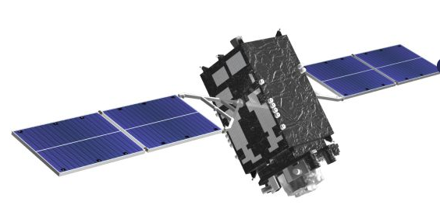
Quazi Zenith constellation for GNSS
Initially three geosynchronous satellites and one geostationary satellite (Michibiki) all broadcasting same L1to L6 signals as GPS and other GNSS systems
http://qzss.go.jp/en/

Slide 79
Quazi Zenith constellation

Slide 80
Orbital debris

Slide 81
Space debris
More than 500,000 pieces of debris or ‘space junk’ are tracked as they orbit the Earth.
This debris can travel at speeds up to 17,500 mph, fast enough for a relatively small piece of orbital debris to damage a satellite or a spacecraft.
The rising population of space debris increases the potential danger to all space vehicles. Such debris includes non-functional spacecraft (Sputnik I is still up there), abandoned launch vehicle stages, mission-related debris and fragmentation debris. Old satellites can contribute substantial debris fields if any hydrazine propellant is not vented at end of life - eventually (through collision with debris or by repeated thermal cycling) the fuel tanks fracture explosively.
There are 500,000 pieces of debris the size of a marble or larger, and many millions of pieces of debris that are so small they can’t be tracked. Even tiny paint flecks can damage a spacecraft when traveling at these velocities (space shuttle windows have been replaced because of damage caused by pain fleck impacts).
There is relatively little debris in GEO and MEO orbits, but substantially more in LEO orbits. Two major events substantially increased the amount of LEO orbital debris:
On Feb. 10, 2009, a defunct Russian satellite collided with and destroyed a functioning U.S. Iridium commercial satellite. The collision added more than 2,000 pieces of trackable debris to the inventory of space junk.
China's 2007 anti-satellite test, which used a missile to destroy an old weather satellite, added more than 3,000 pieces to the debris problem.
Objects are now being actively tracked by a number of dedicated radars around the world, with satellite operators being informed of potential collisions. The position of the International Space Station is regularly adjusted to avoid potential collisions with larger items.

Slide 82
Space debris
Geostationary satellites are spaced just over 75 km apart and debris-related failures are rare (once every decade). Older spacecraft are ‘parked’ at a higher orbit to avoid potential collisions (and to allow their orbital slot to be reused).
NEWLEGACYLEOs have typically lost a satellite once every three years but the satellites are usually backed with spare satellites in a lower back up orbit.
The risk of more collisions will clearly increase with the projected substantial (x3?) increase in LEO satellite deployments, and debris management will become significant and a potential cost overhead for the NEWLEO operator community.
Guidelines have been proposed to ensure that satellites at the end of their lives can be vented (‘passivated’), and either deorbited in a controlled fashion (ideally for LEO satellites to burn up in the atmosphere, although this isn’t necessarily possible with larger satellites), or placed in ‘safe’ orbits. The majority of nations launching satellites (and the UK) have now signed up to these: however China is not a signatory.
Initiatives to actively reduce the amount of space debris have been proposed by a number of organisations, and ESA (the European Space Agency) is very active in this field.

Slide 83
HTA and LTA
Heavier Than Air

Slide 84
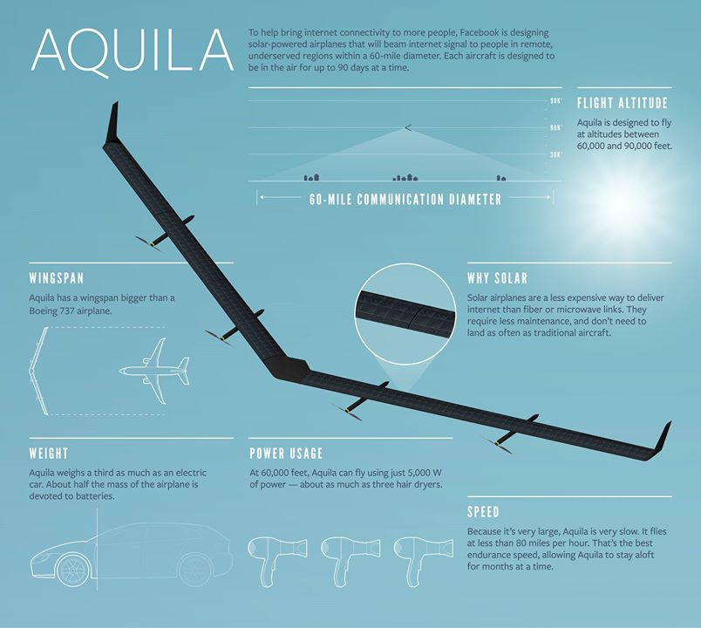
HTA and LTA

Slide 85
LTA

Slide 86
LTA - Lighter Than Air

Slide 87
Google Loon

