Slide 1
5G and satellite spectrum, standards and scale
The race for space spectrum at WRC 2019
Compatibility/coexistence with GSO, LEO and MEO Ku, K and Ka-band satellite spectrum with 5G terrestrial including 28 GHz
NEW LEO constellation capabilities including OneWeb and Space X and LEOSAT
Progressive pitch angular power separation- Spectrum sharing and frequency reuse opportunities and challenges.
Pass bands and channel bandwidth compatibility and physical layer coexistence
Present tension points between NEWLEO entities and incumbent LEO and MEO and GSO operators
Link link budget and long distance latency benefits of nearly always nearly overhead (NANO) or always overhead (AO) connectivity when integrated with inter satellite switching
How this could help meet specific 5G vertical market throughput and latency requirements
Satellite IOT, present and future technical and commercial trends and standards issues
Related 5G and satellite regulatory and competition policy challenges and opportunities, longer term V and W band co sharing opportunities

Slide 2
Satellite orbits
LEO, MEO and GSO orbits- with thanks to Inmarsat

Slide 3
GSO Orbital slots
With thanks to the Boeing Corporation

Slide 4
LEO ORBITS and satellites sizes

Slide 5
Bands Agreed For Study at WRC 2019

Slide 6
Bands Agreed For Study at WRC 2019- E band

Slide 7
Existing LEO band plans -Iridium

Slide 8
O3b - formerly the band plan for Teledesic

Slide 9
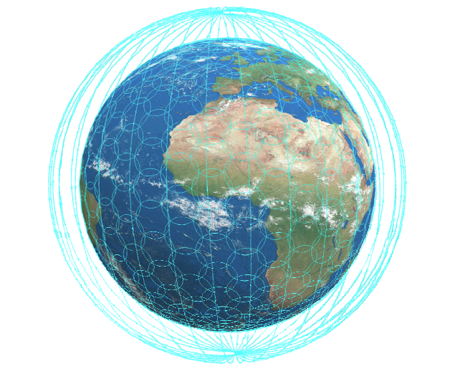
OneWeb Ku-Band - formerly the band plan for Skybridge

Slide 10
OneWeb Ka-Band formerly the band plan for Skybridge

Slide 11
O3b Progressive Pitch MEO to GSO separation

Slide 12
OneWeb Progressive Pitch LEO to GSO separation
So can 28 GHz and other K bands be shared with 5G terrestrial?
LEO to MEO to GSO to 5G separation

Slide 13
Boeing V band progressive pitch+ fractional beam width
37.5 to 42.5 GHz downlinking from spacecraft to terminals on Earth
47.2 to 50.2 GHz and 50.4 to 52.4 GHz for uplinking back to the satellites
The industry rumour mill in 2017 suggested Apple was providing finance
See also Google and OneWeb, Jeff Bezos (Amazon) and Blue Origin, Mark Zuckerberg (Facebook) and Eutelsat

Slide 14
Terrestrial latency versus space latency

Slide 15
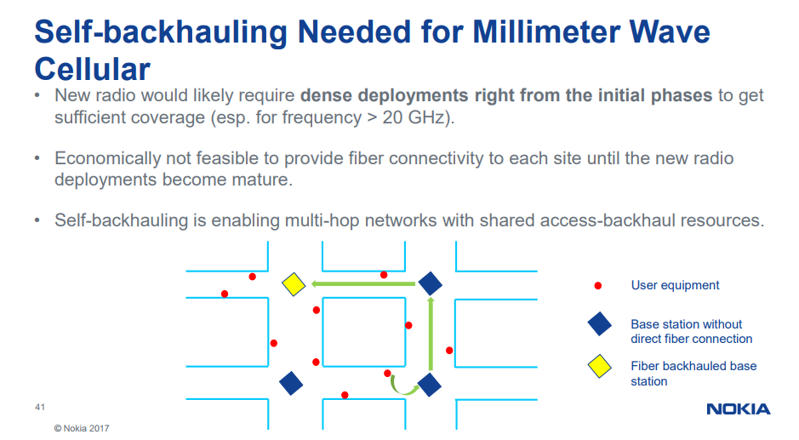
Self backhauling- A Nokia Example

Slide 16
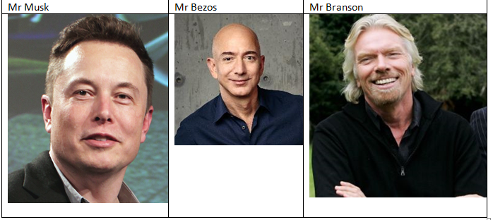
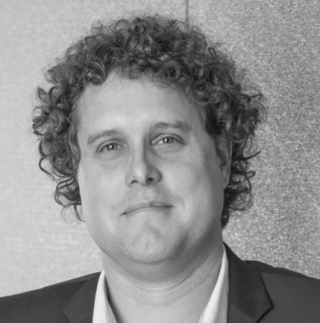
New Rocket Age? New Rocket men?
Peter Beck Rocket lab USA

Slide 17
New Space? New Delivery Economics?
Plus satellite innovations – electric satellites, new propulsion and power options

